Slide 1
INTRODUCTION TO STATISTICS
LECTURE 4

Slide 2
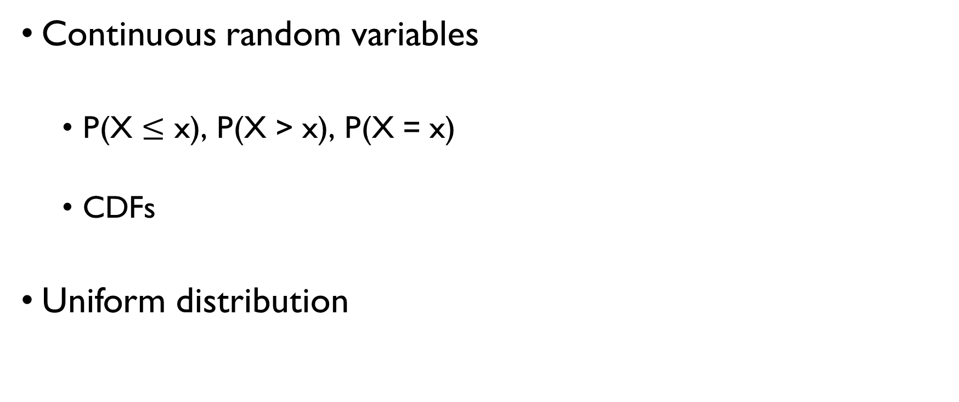
LAST TIME
Continuous random variables
P(X $≤$ x), P(X > x), P(X = x)
CDFs
Uniform distribution

Slide 3
TODAY
Probability density function (PDF)
PDF and CDF
Properties of continuous random variables
Mean
Variance
+ 1 more continuous distribution

Slide 4
SHORT QUIZ
CDFs

Slide 5


SHORT QUIZ
CDF F(x) = P(X $≤$ x)
Probability mass function
F(5)
1 – F(3)
F(2) – F(-1)
F(-3) – F(-5)
F(5) – F(3) + F(-1) – F(-5)
P(X $≤$ 5)
P(X > 3)
P(-1 < X $≤$ 2)
P(-5 < X $≤$ -3)
P(3 < X $≤$ 5 or -5 < X $≤$ -1)

Slide 6
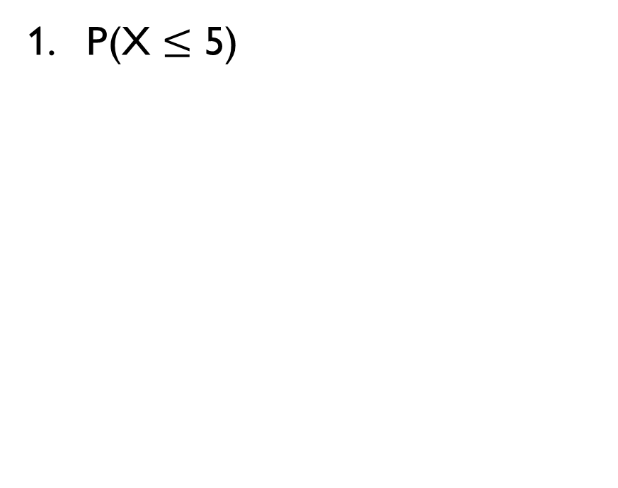
SHORT QUIZ
CDF F(x) = P(X $≤$ x)
Probability mass function
F(5)
1 – F(3)
F(2) – F(-1)
F(-3) – F(-5)
F(5) – F(3) + F(-1) – F(-5)
P(X $≤$ 5)
P(X > 3)
P(-1 < X $≤$ 2)
P(-5 < X $≤$ -3)
P(3 < X $≤$ 5 or -5 < X $≤$ -1)

Slide 7
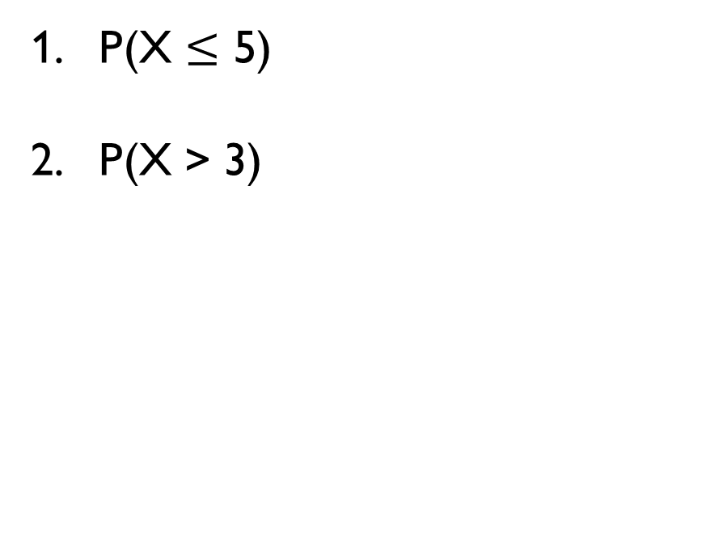
SHORT QUIZ
CDF F(x) = P(X $≤$ x)
Probability mass function
F(5)
1 – F(3)
F(2) – F(-1)
F(-3) – F(-5)
F(5) – F(3) + F(-1) – F(-5)
P(X $≤$ 5)
P(X > 3)
P(-1 < X $≤$ 2)
P(-5 < X $≤$ -3)
P(3 < X $≤$ 5 or -5 < X $≤$ -1)

Slide 8
SHORT QUIZ
CDF F(x) = P(X $≤$ x)
Probability mass function
F(5)
1 – F(3)
F(2) – F(-1)
F(-3) – F(-5)
F(5) – F(3) + F(-1) – F(-5)
P(X $≤$ 5)
P(X > 3)
P(-1 < X $≤$ 2)
P(-5 < X $≤$ -3)
P(3 < X $≤$ 5 or -5 < X $≤$ -1)

Slide 9
SHORT QUIZ
CDF F(x) = P(X $≤$ x)
Probability mass function
F(5)
1 – F(3)
F(2) – F(-1)
F(-3) – F(-5)
F(5) – F(3) + F(-1) – F(-5)
P(X $≤$ 5)
P(X > 3)
P(-1 < X $≤$ 2)
P(-5 < X $≤$ -3)
P(3 < X $≤$ 5 or -5 < X $≤$ -1)

Slide 10
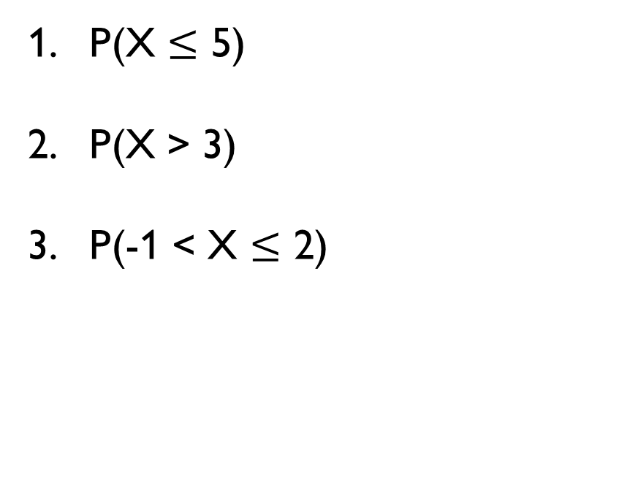
SHORT QUIZ
CDF F(x) = P(X $≤$ x)
Probability mass function
F(5)
1 – F(3)
F(2) – F(-1)
F(-3) – F(-5)
F(5) – F(3) + F(-1) – F(-5)
P(X $≤$ 5)
P(X > 3)
P(-1 < X $≤$ 2)
P(-5 < X $≤$ -3)
P(3 < X $≤$ 5 or -5 < X $≤$ -1)

Slide 11
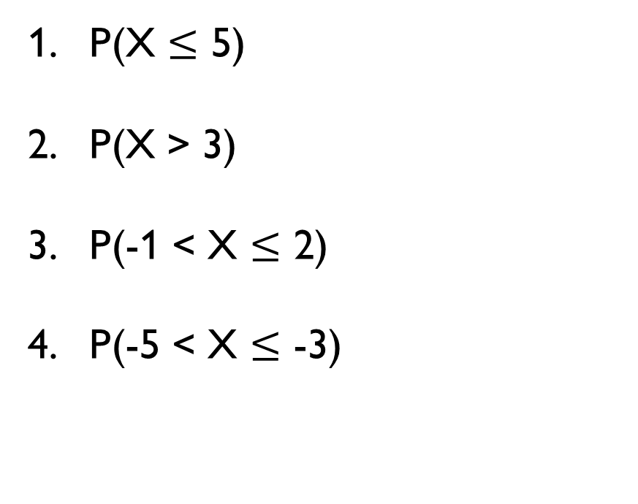
SHORT QUIZ
CDF F(x) = P(X $≤$ x)
Probability mass function
F(5)
1 – F(3)
F(2) – F(-1)
F(-3) – F(-5)
F(5) – F(3) + F(-1) – F(-5)
P(X $≤$ 5)
P(X > 3)
P(-1 < X $≤$ 2)
P(-5 < X $≤$ -3)
P(3 < X $≤$ 5 or -5 < X $≤$ -1)

Slide 12
SHORT QUIZ
CDF F(x) = P(X $≤$ x)
Probability mass function
F(5)
1 – F(3)
F(2) – F(-1)
F(-3) – F(-5)
F(5) – F(3) + F(-1) – F(-5)
P(X $≤$ 5)
P(X > 3)
P(-1 < X $≤$ 2)
P(-5 < X $≤$ -3)
P(3 < X $≤$ 5 or -5 < X $≤$ -1)

Slide 13
SHORT QUIZ
CDF F(x) = P(X $≤$ x)
Probability mass function
F(5)
1 – F(3)
F(2) – F(-1)
F(-3) – F(-5)
F(5) – F(3) + F(-1) – F(-5)
P(X $≤$ 5)
P(X > 3)
P(-1 < X $≤$ 2)
P(-5 < X $≤$ -3)
P(3 < X $≤$ 5 or -5 < X $≤$ -1)

Slide 14
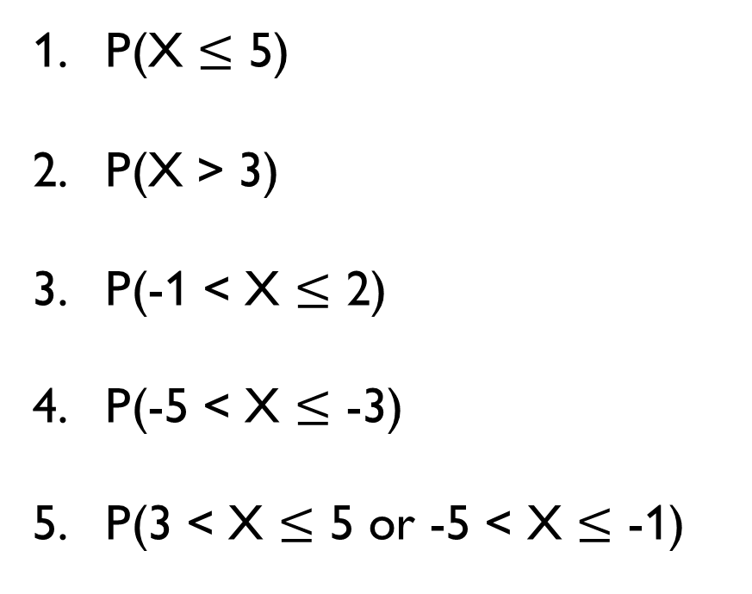
SHORT QUIZ
CDF F(x) = P(X $≤$ x)
Probability mass function
F(5)
1 – F(3)
F(2) – F(-1)
F(-3) – F(-5)
F(5) – F(3) + F(-1) – F(-5)
P(X $≤$ 5)
P(X > 3)
P(-1 < X $≤$ 2)
P(-5 < X $≤$ -3)
P(3 < X $≤$ 5 or -5 < X $≤$ -1)

Slide 15
PROBABILITY DENSITY FUNCTION
PDFs

Slide 16
WATCH THE VIDEO
https://youtu.be/PUvUQMQ7xQk

Slide 17
NOW, LET’S DISCUSS IT STEP BY STEP

Slide 18
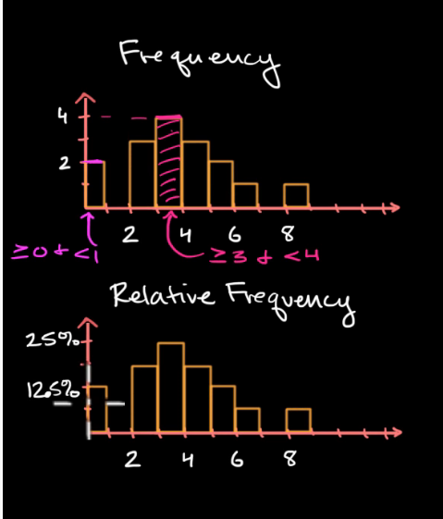
HISTOGRAMS
What’s the difference between ‘frequency’ and ‘relative frequency’ histograms?
When one is better than another?

Slide 19
HISTOGRAMS
What’s the difference between ‘frequency’ and ‘relative frequency’ histograms (as stated in the video)?
When one is better than another?

Slide 20
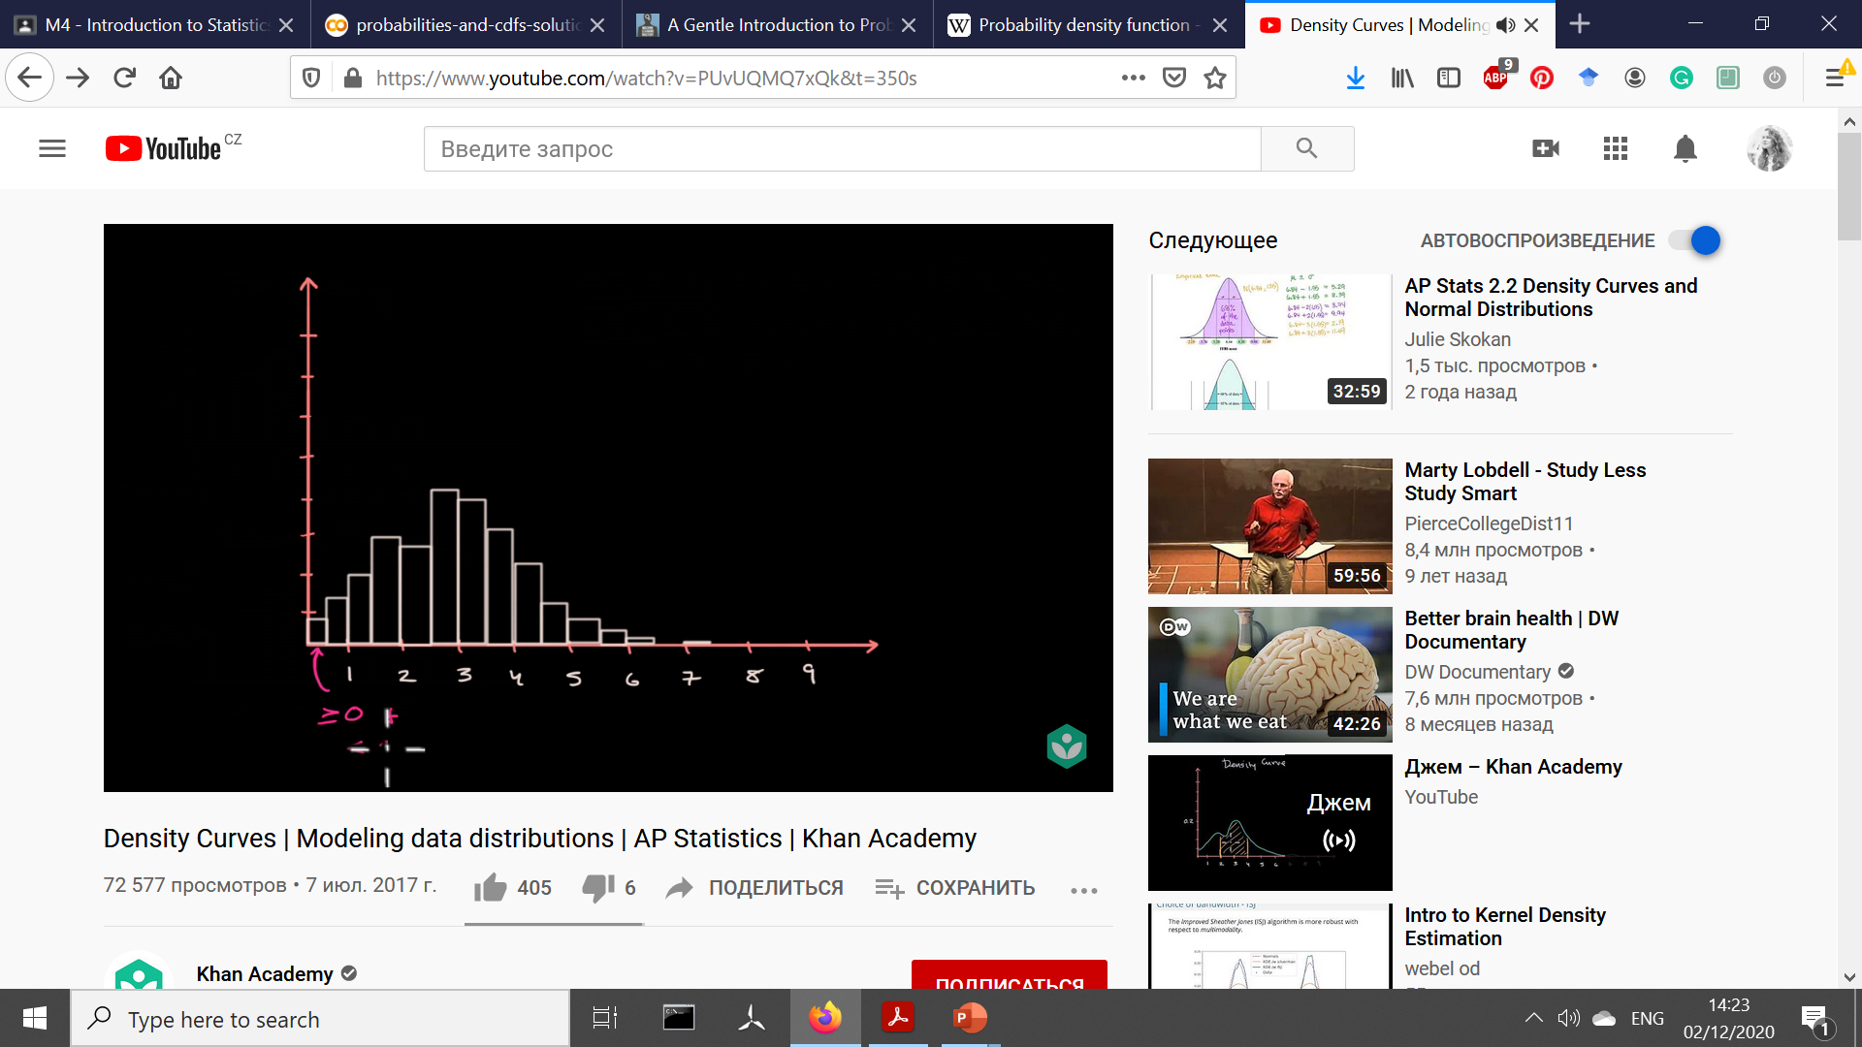
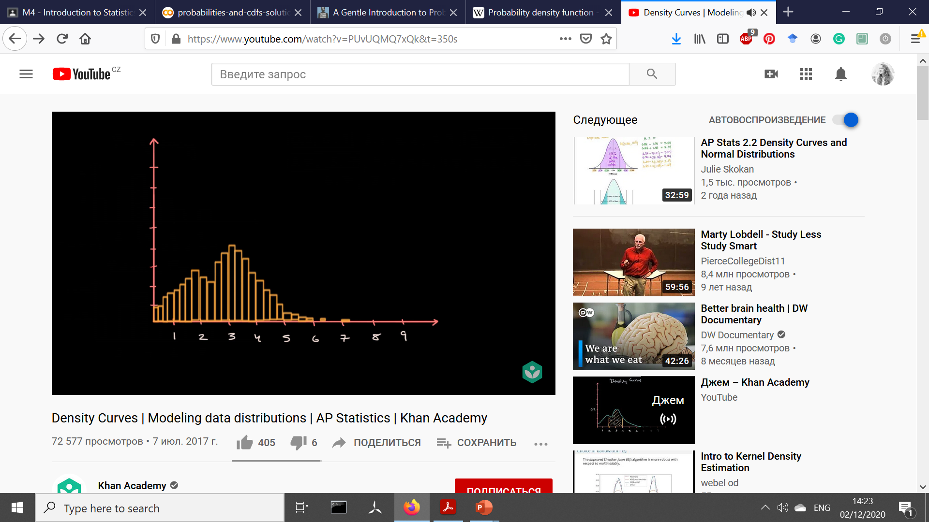

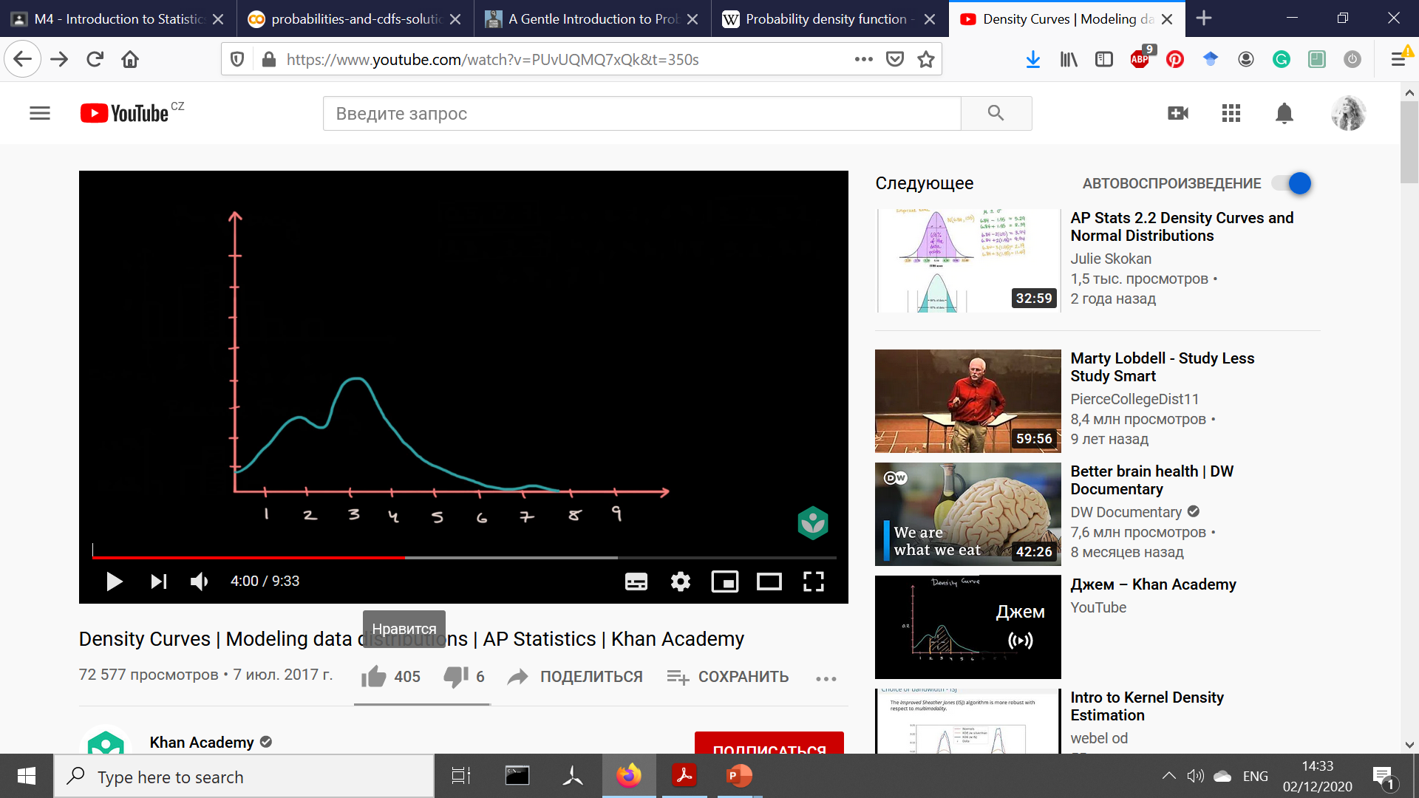
DENSITY: ESTIMATION
How did they obtain the density?

Slide 21
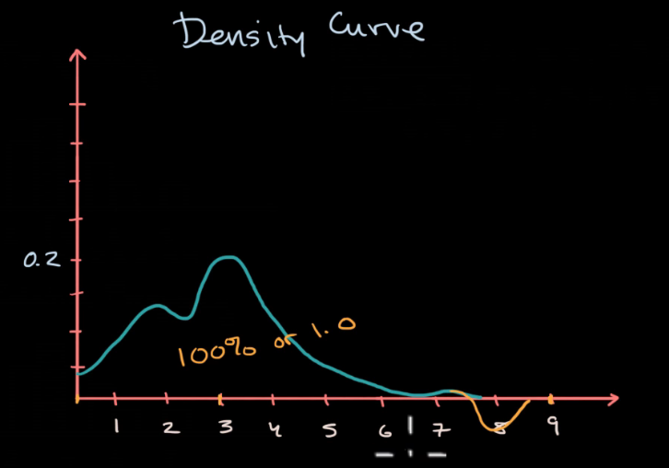
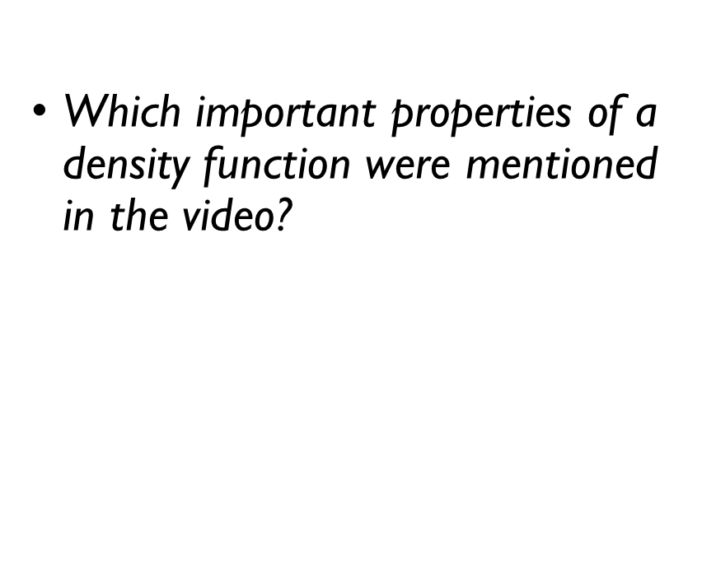
DENSITY: BASIC PROPERTIES
Which important properties of a density function were mentioned in the video?
area under the curve is 1;
p(x) $≥$ 0.

Slide 22
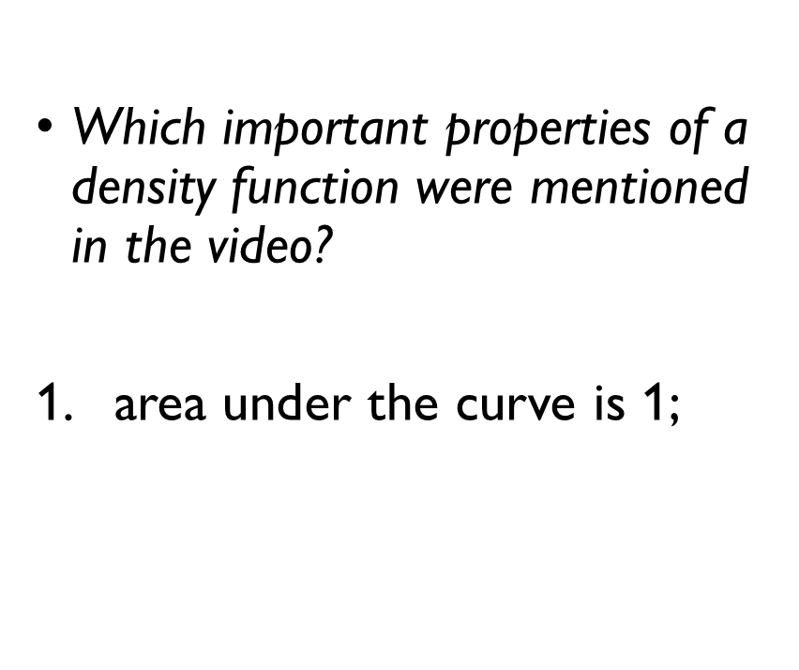
DENSITY: BASIC PROPERTIES
Which important properties of a density function were mentioned in the video?
area under the curve is 1;
p(x) $≥$ 0.

Slide 23
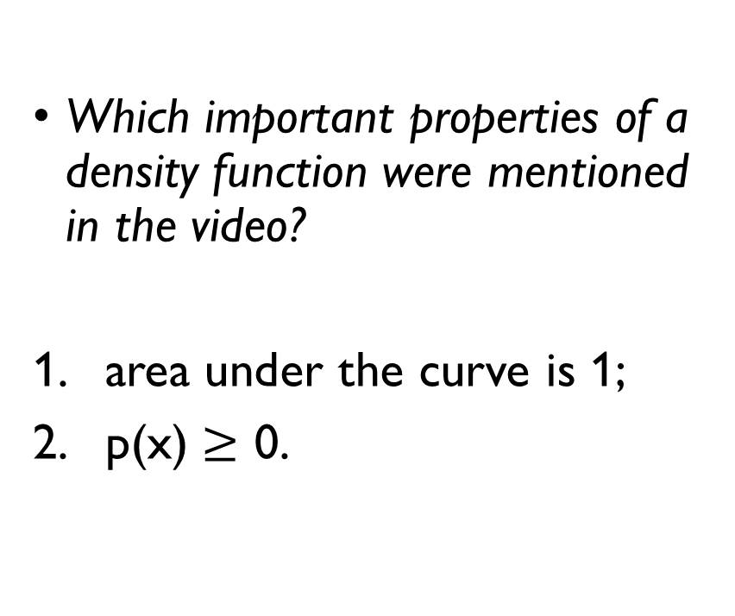
DENSITY: BASIC PROPERTIES
Which important properties of a density function were mentioned in the video?
area under the curve is 1;
p(x) $≥$ 0.

Slide 24
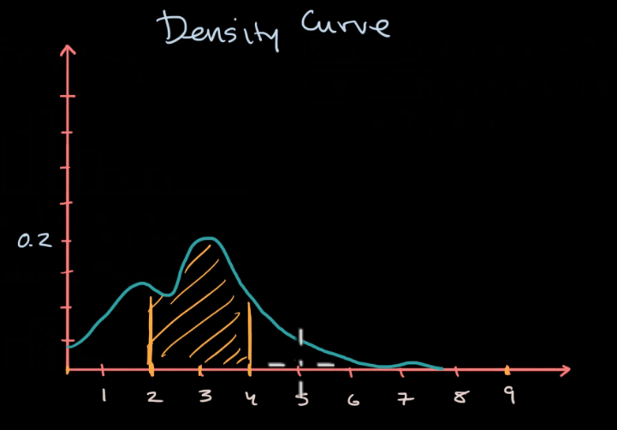
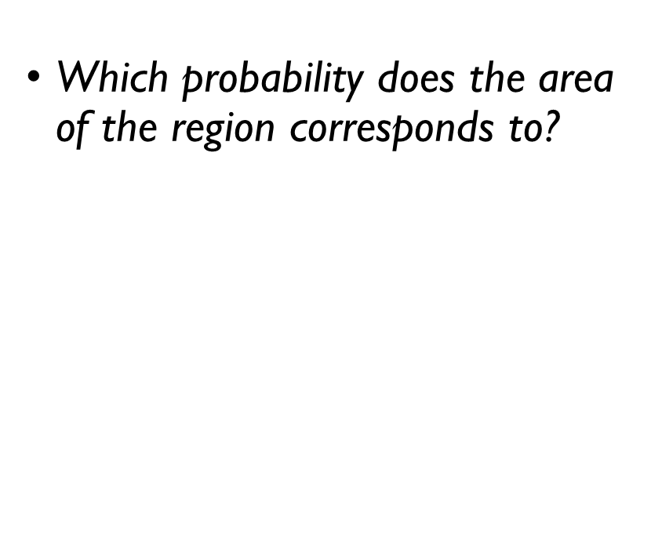
DENSITY: AREA UNDER THE CURVE
Which probability does the area of the region corresponds to?
P(2 $<$ X $≤$ 4)
How to formulate it with CDF?
F(4) – F(2)

Slide 25
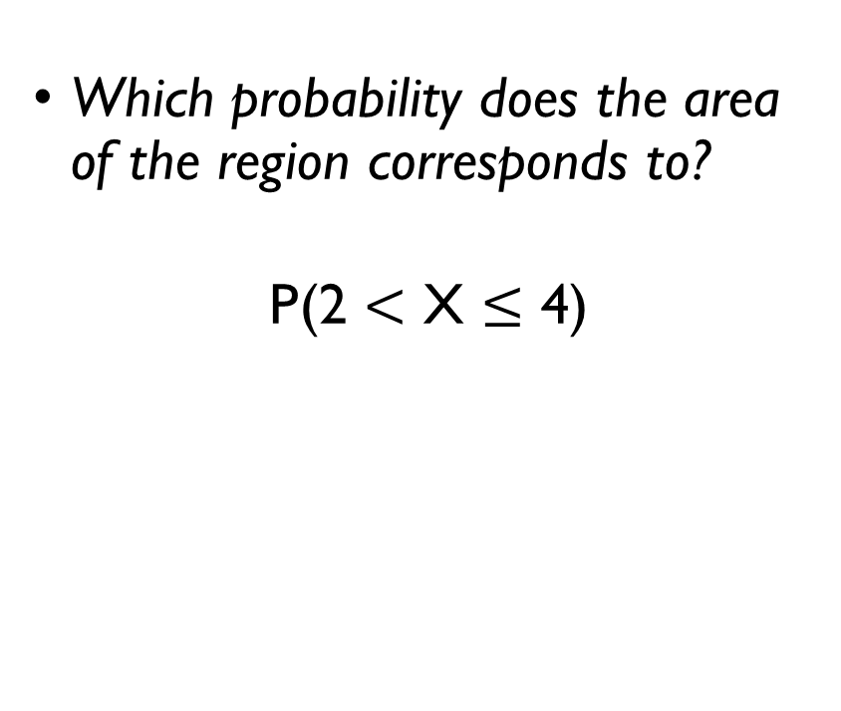
DENSITY: AREA UNDER THE CURVE
Which probability does the area of the region corresponds to?
P(2 $<$ X $≤$ 4)
How to formulate it with CDF?
F(4) – F(2)

Slide 26
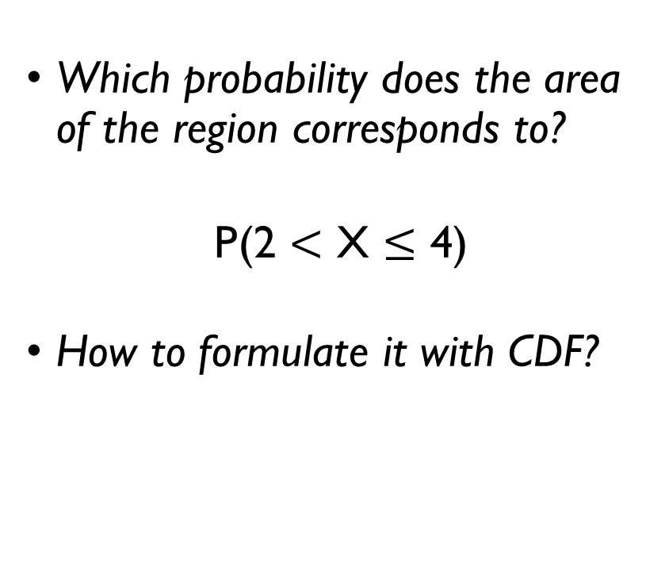
DENSITY: AREA UNDER THE CURVE
Which probability does the area of the region corresponds to?
P(2 $<$ X $≤$ 4)
How to formulate it with CDF?
F(4) – F(2)

Slide 27
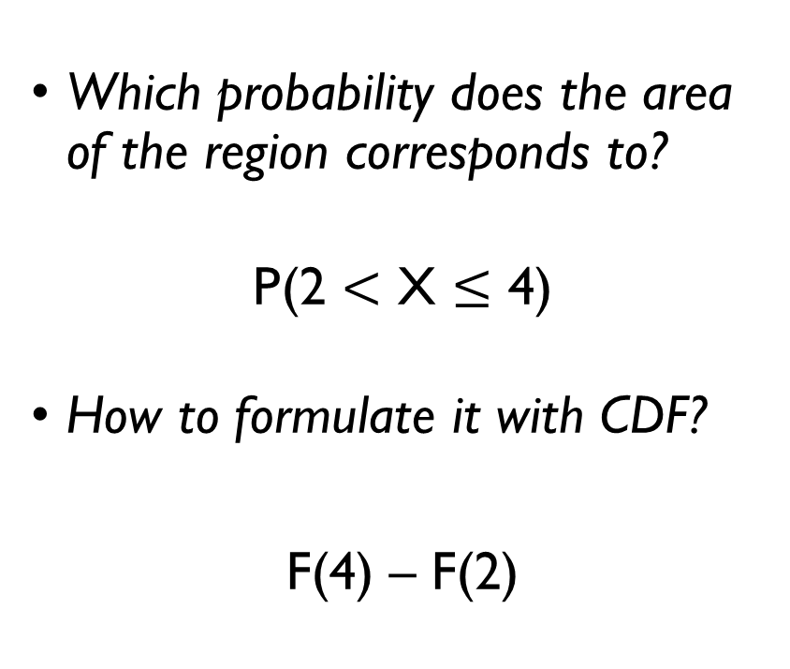
DENSITY: AREA UNDER THE CURVE
Which probability does the area of the region corresponds to?
P(2 $<$ X $≤$ 4)
How to formulate it with CDF?
F(4) – F(2)

Slide 28
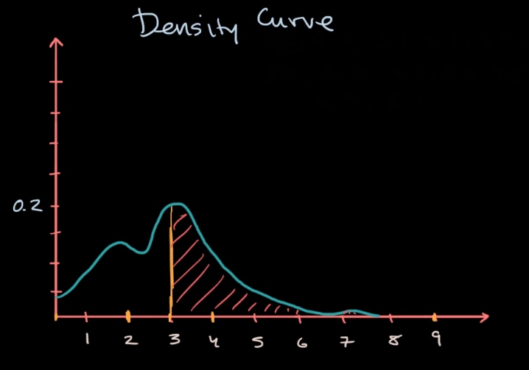
DENSITY: AREA UNDER THE CURVE
Which probability does the area of the region corresponds to?
P(X > 3)
How to formulate it with CDF?
1 – F(3)

Slide 29
DENSITY: AREA UNDER THE CURVE
Which probability does the area of the region corresponds to?
P(X > 3)
How to formulate it with CDF?
1 – F(3)

Slide 30
DENSITY: AREA UNDER THE CURVE
Which probability does the area of the region corresponds to?
P(X > 3)
How to formulate it with CDF?
1 – F(3)

Slide 31
DENSITY: AREA UNDER THE CURVE
Which probability does the area of the region corresponds to?
P(X > 3)
How to formulate it with CDF?
1 – F(3)

Slide 32
DENSITY: AREA UNDER THE CURVE
Which probability does the area of the region corresponds to?
P(X > 3)
How to formulate it with CDF?
1 – F(3)
F(3)

Slide 33
THERE IS A MISTAKE IN A VIDEO THOUGH…
Google Classroom -> [Python] From histograms to density

Slide 34
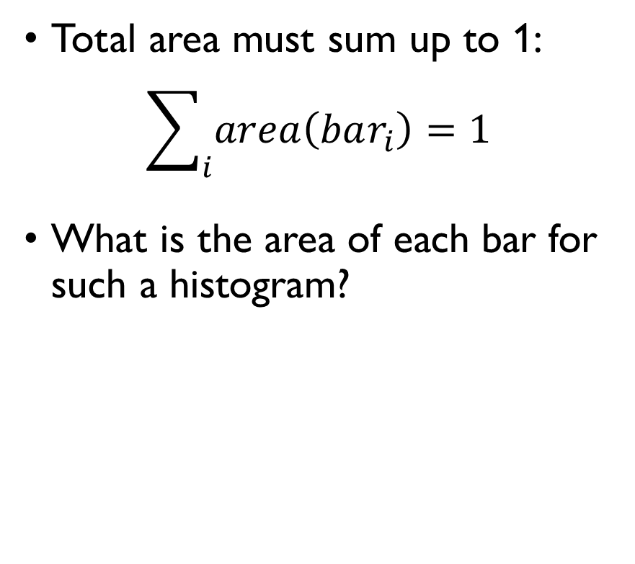
NORMALIZING BIN HEIGHTS
Total area must sum up to 1:
$$\sum_{i}{area\left(bar_{i}\right)}=1$$
What is the area of each bar for such a histogram?
bin height x bin width
relative frequency x bin width
$$→0 \\ when bin width →0$$

Slide 35
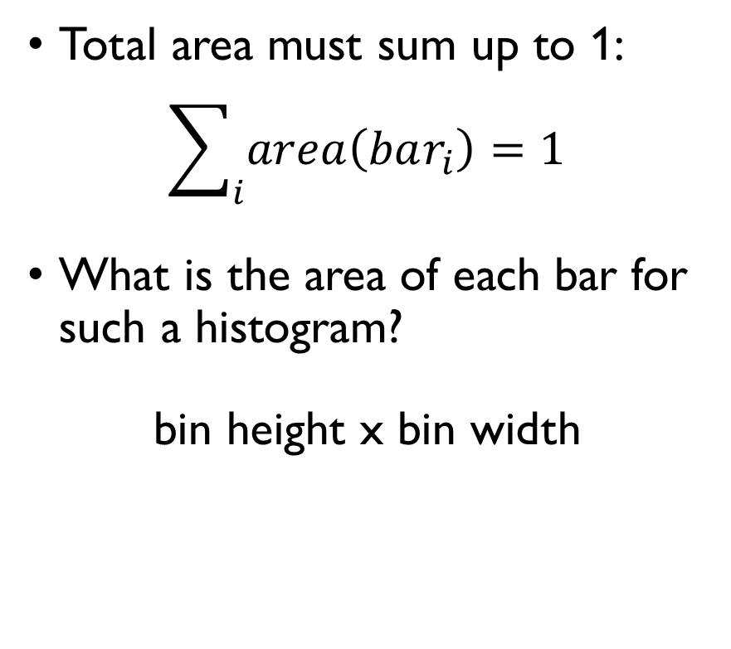
NORMALIZING BIN HEIGHTS
Total area must sum up to 1:
$$\sum_{i}{area\left(bar_{i}\right)}=1$$
What is the area of each bar for such a histogram?
bin height x bin width
relative frequency x bin width
$$→0 \\ when bin width →0$$

Slide 36
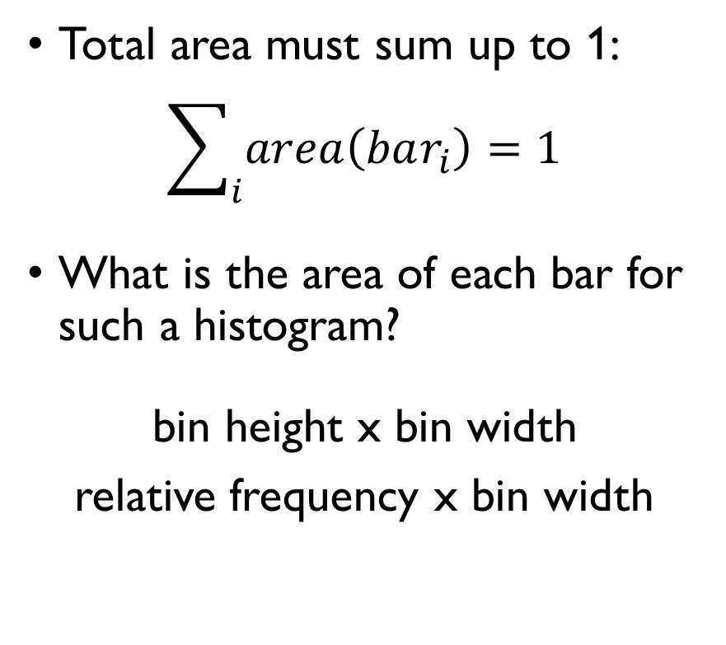
NORMALIZING BIN HEIGHTS
Total area must sum up to 1:
$$\sum_{i}{area\left(bar_{i}\right)}=1$$
What is the area of each bar for such a histogram?
bin height x bin width
relative frequency x bin width
$$→0 \\ when bin width →0$$

Slide 37
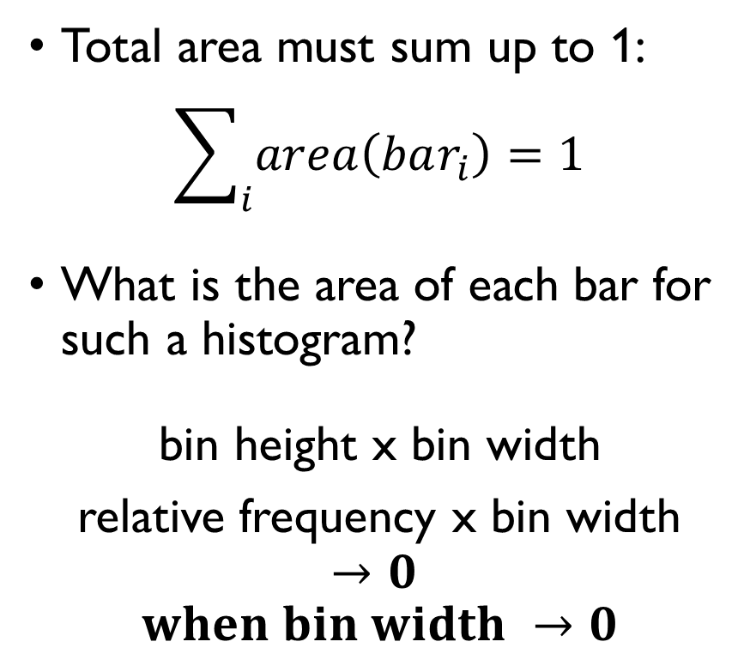
NORMALIZING BIN HEIGHTS
Total area must sum up to 1:
$$\sum_{i}{area\left(bar_{i}\right)}=1$$
What is the area of each bar for such a histogram?
bin height x bin width
relative frequency x bin width
$$→0 \\ when bin width →0$$

Slide 38
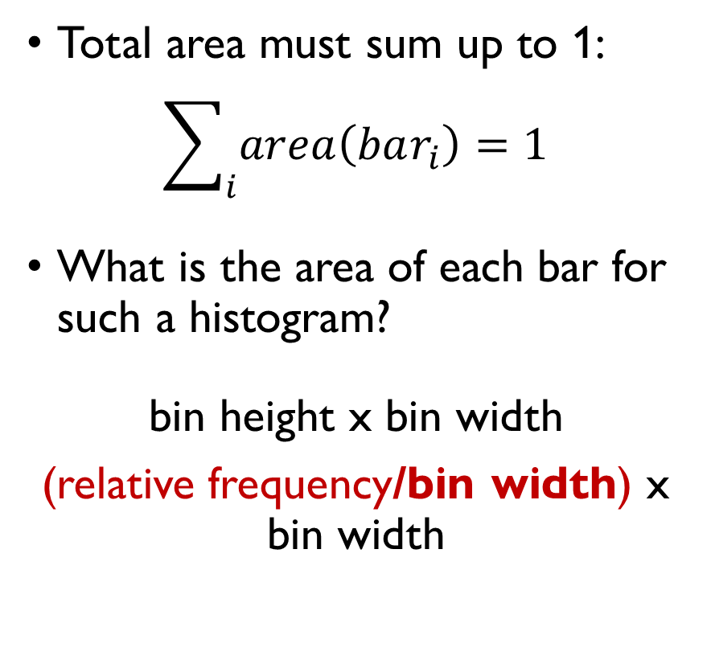
NORMALIZING BIN HEIGHTS
Total area must sum up to 1:
$$\sum_{i}{area\left(bar_{i}\right)}=1$$
What is the area of each bar for such a histogram?
bin height x bin width
(relative frequency/bin width) x bin width
always sums up to 1

Slide 39
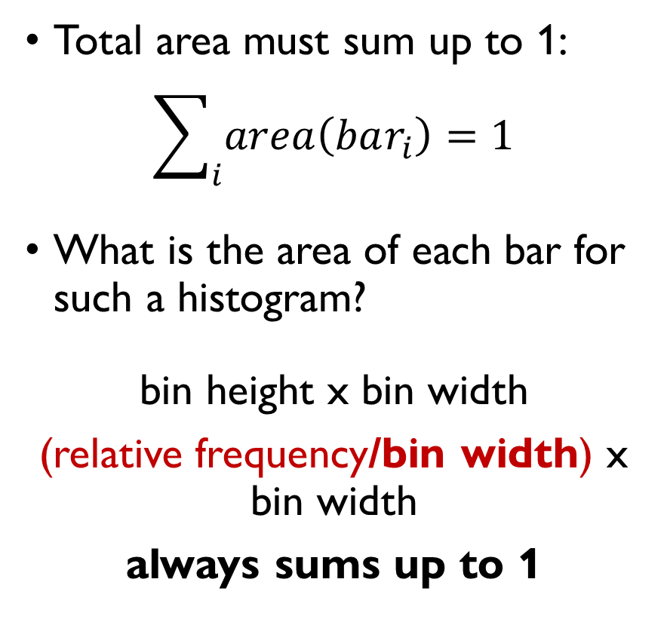
NORMALIZING BIN HEIGHTS
Total area must sum up to 1:
$$\sum_{i}{area\left(bar_{i}\right)}=1$$
What is the area of each bar for such a histogram?
bin height x bin width
(relative frequency/bin width) x bin width
always sums up to 1

Slide 40
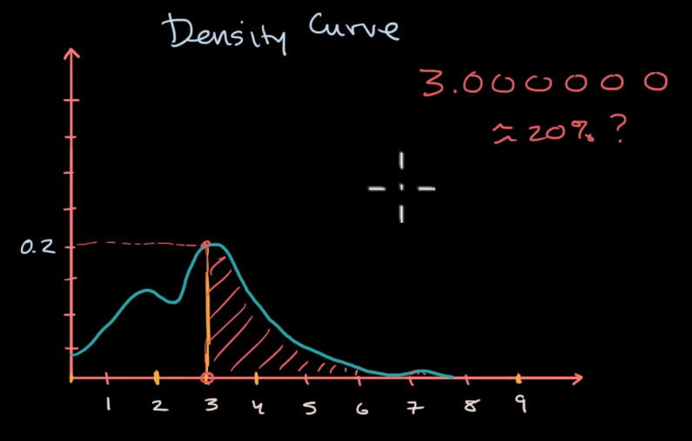
DENSITY: INTERPRETATION
What is P(X = 3)?
P(X = 3) = 0
What does it mean that p(3) = 0.2?

Slide 41
DENSITY: INTERPRETATION
What is P(X = 3)?
P(X = 3) = 0
What does it mean that p(3) = 0.2?

Slide 42
RELATION BETWEEN CDF AND DENSITY

Slide 43
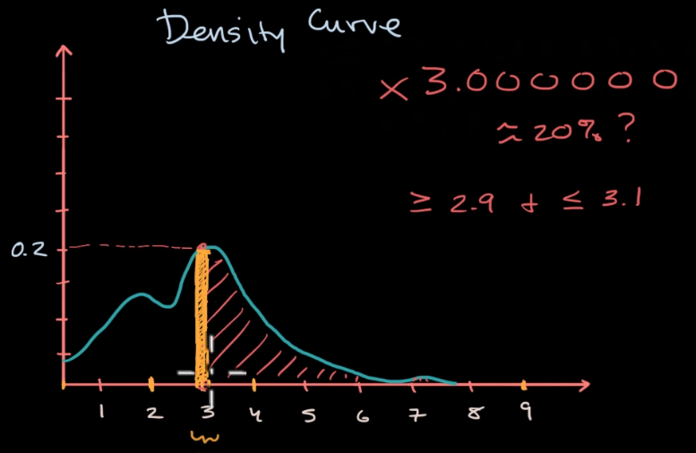
DENSITY: INTERPRETATION
How did they estimate the area under the curve?
Do you remember how to compute it exactly?

Slide 44
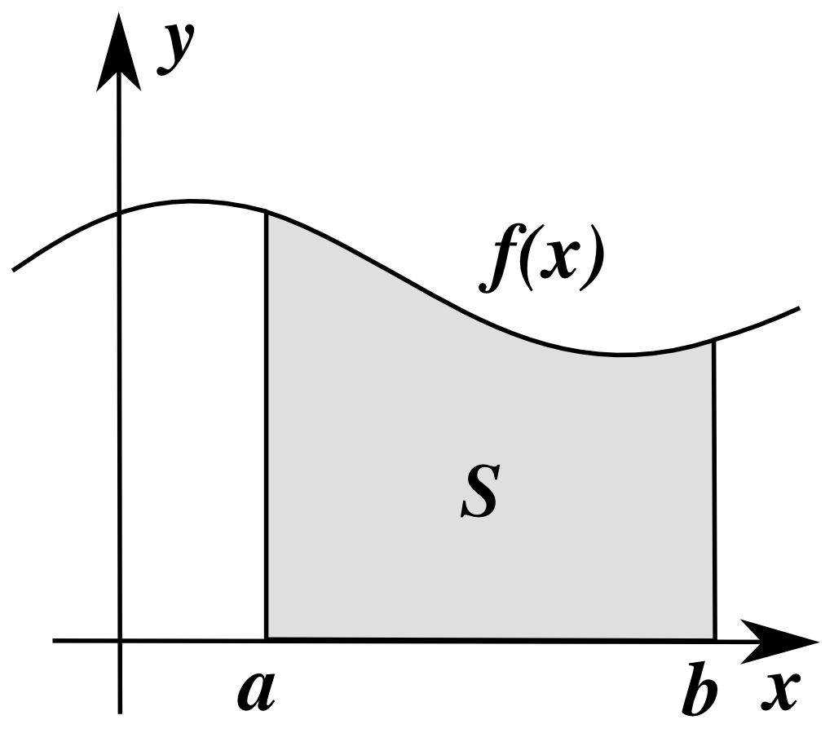

DENSITY: INTERPRETATION
How did they estimate the area under the curve?
Do you remember how to compute it exactly?
$$=\int_{a}^{b}{f\left(x\right)dx}$$

Slide 45
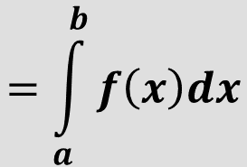
DENSITY: INTERPRETATION
How did they estimate the area under the curve?
Do you remember how to compute it exactly?
$$=\int_{a}^{b}{f\left(x\right)dx}$$

Slide 46

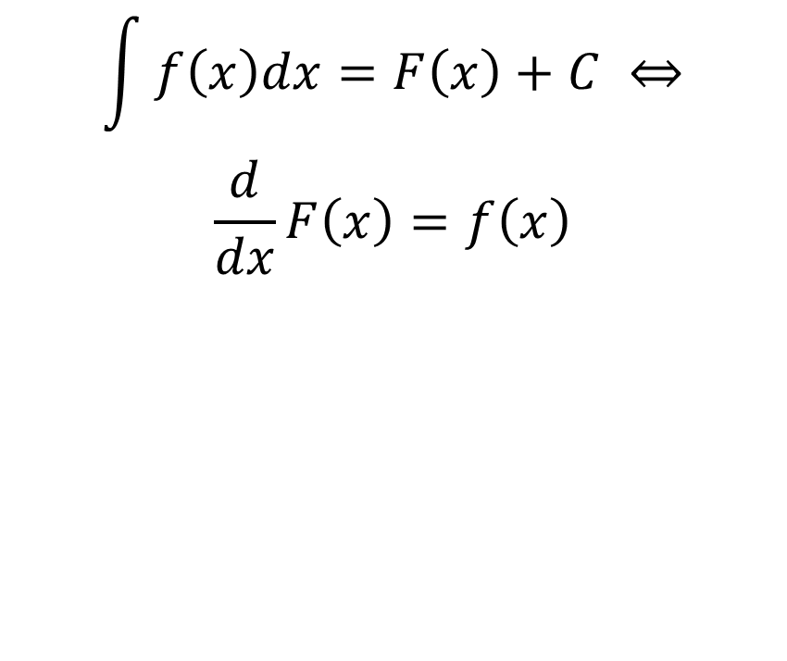
CALCULUS 101
$$\int{f\left(x\right)dx}=F\left(x\right)+C ⇔$$
$$\frac{d}{dx}F\left(x\right)=f\left(x\right)$$
$$\int_{a}^{b}{f\left(x\right)dx}=F\left(b\right)−F\left(a\right)$$
$$\int{xdx}=\frac{x^{2}}{2}+C$$
$$\int{\frac{1}{x}dx}=\log{x}+C$$
$\int_{0}^{1}{xdx}=\frac{1^{2}}{2}−\frac{0^{2}}{2}=\frac{1}{2}$

Slide 47
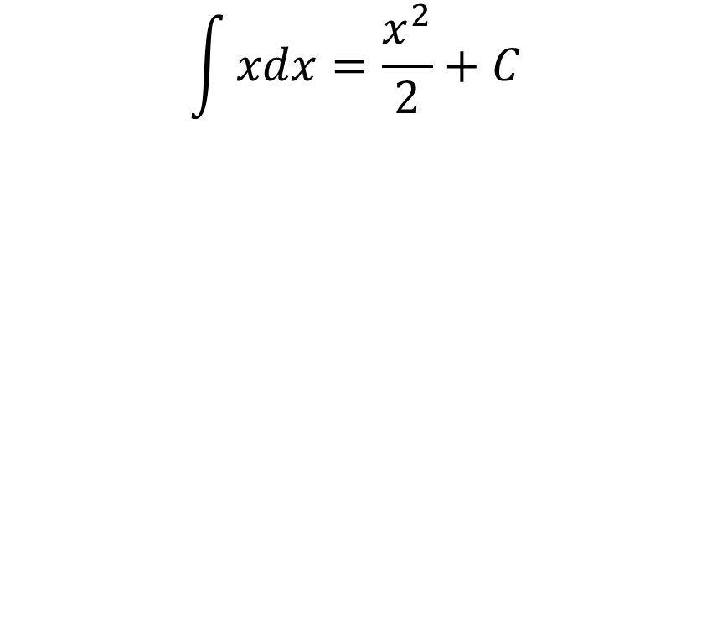
CALCULUS 101
$$\int{f\left(x\right)dx}=F\left(x\right)+C ⇔$$
$$\frac{d}{dx}F\left(x\right)=f\left(x\right)$$
$$\int_{a}^{b}{f\left(x\right)dx}=F\left(b\right)−F\left(a\right)$$
$$\int{xdx}=\frac{x^{2}}{2}+C$$
$$\int{\frac{1}{x}dx}=\log{x}+C$$
$\int_{0}^{1}{xdx}=\frac{1^{2}}{2}−\frac{0^{2}}{2}=\frac{1}{2}$

Slide 48
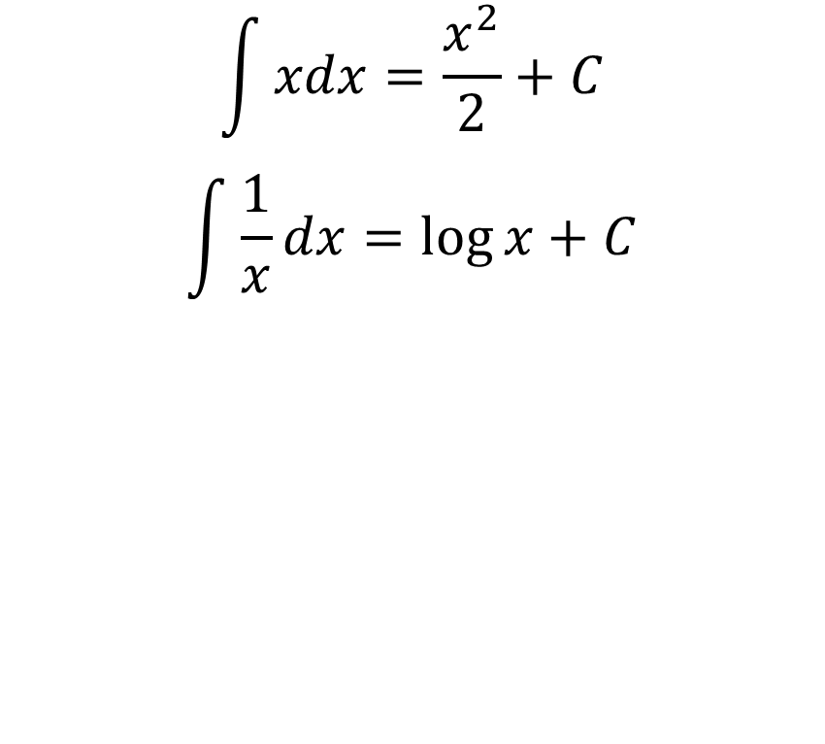
CALCULUS 101
$$\int{f\left(x\right)dx}=F\left(x\right)+C ⇔$$
$$\frac{d}{dx}F\left(x\right)=f\left(x\right)$$
$$\int_{a}^{b}{f\left(x\right)dx}=F\left(b\right)−F\left(a\right)$$
$$\int{xdx}=\frac{x^{2}}{2}+C$$
$$\int{\frac{1}{x}dx}=\log{x}+C$$
$\int_{0}^{1}{xdx}=\frac{1^{2}}{2}−\frac{0^{2}}{2}=\frac{1}{2}$

Slide 49
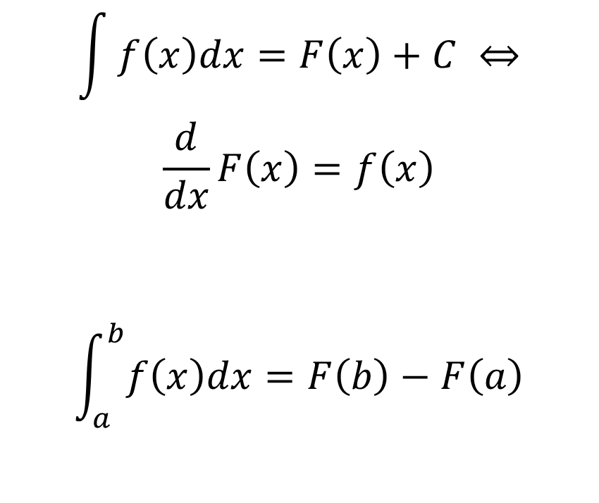
CALCULUS 101
$$\int{f\left(x\right)dx}=F\left(x\right)+C ⇔$$
$$\frac{d}{dx}F\left(x\right)=f\left(x\right)$$
$$\int_{a}^{b}{f\left(x\right)dx}=F\left(b\right)−F\left(a\right)$$
$$\int{xdx}=\frac{x^{2}}{2}+C$$
$$\int{\frac{1}{x}dx}=\log{x}+C$$
$\int_{0}^{1}{xdx}=\frac{1^{2}}{2}−\frac{0^{2}}{2}=\frac{1}{2}$

Slide 50
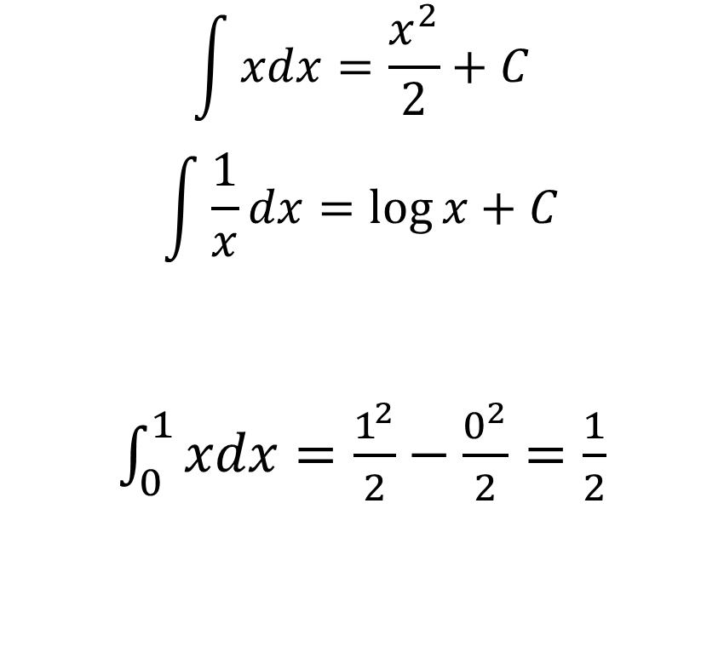
CALCULUS 101
$$\int{f\left(x\right)dx}=F\left(x\right)+C ⇔$$
$$\frac{d}{dx}F\left(x\right)=f\left(x\right)$$
$$\int_{a}^{b}{f\left(x\right)dx}=F\left(b\right)−F\left(a\right)$$
$$\int{xdx}=\frac{x^{2}}{2}+C$$
$$\int{\frac{1}{x}dx}=\log{x}+C$$
$\int_{0}^{1}{xdx}=\frac{1^{2}}{2}−\frac{0^{2}}{2}=\frac{1}{2}$

Slide 51
DENSITY: AREA UNDER THE CURVE
Which probability does the area of the region corresponds to?
P(2 $<$ X $≤$ 4)
How to formulate it with CDF?
F(4) – F(2)

Slide 52
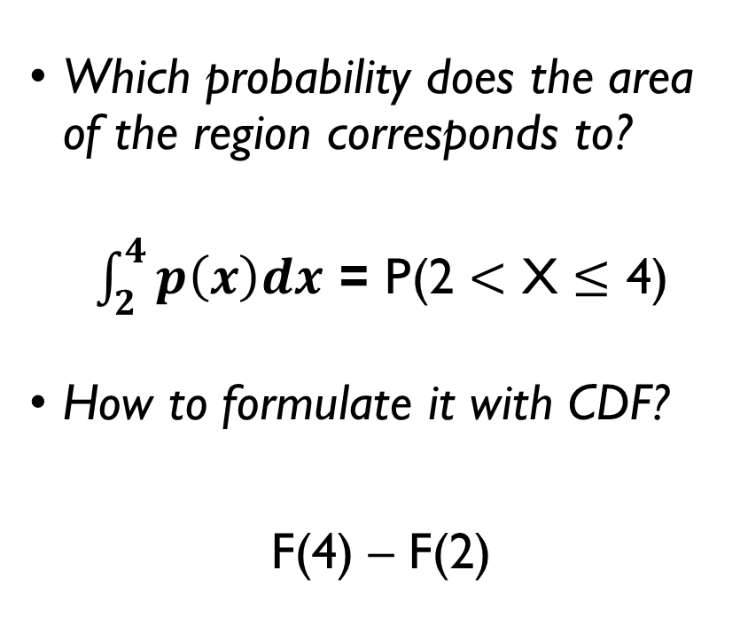
DENSITY: AREA UNDER THE CURVE
Which probability does the area of the region corresponds to?
$\int_{2}^{4}{p\left(x\right)dx}$ = P(2 $<$ X $≤$ 4)
How to formulate it with CDF?
F(4) – F(2)

Slide 53
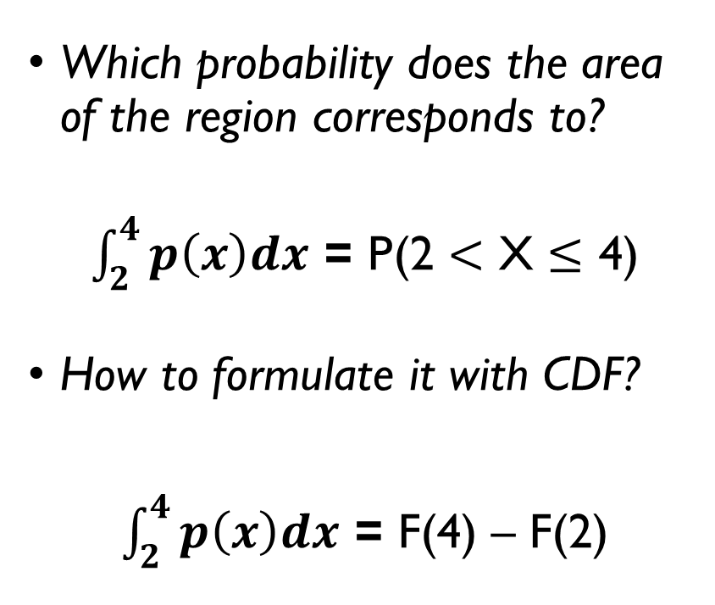
DENSITY: AREA UNDER THE CURVE
Which probability does the area of the region corresponds to?
$\int_{2}^{4}{p\left(x\right)dx}$ = P(2 $<$ X $≤$ 4)
How to formulate it with CDF?
$\int_{2}^{4}{p\left(x\right)dx}$ = F(4) – F(2)

Slide 54
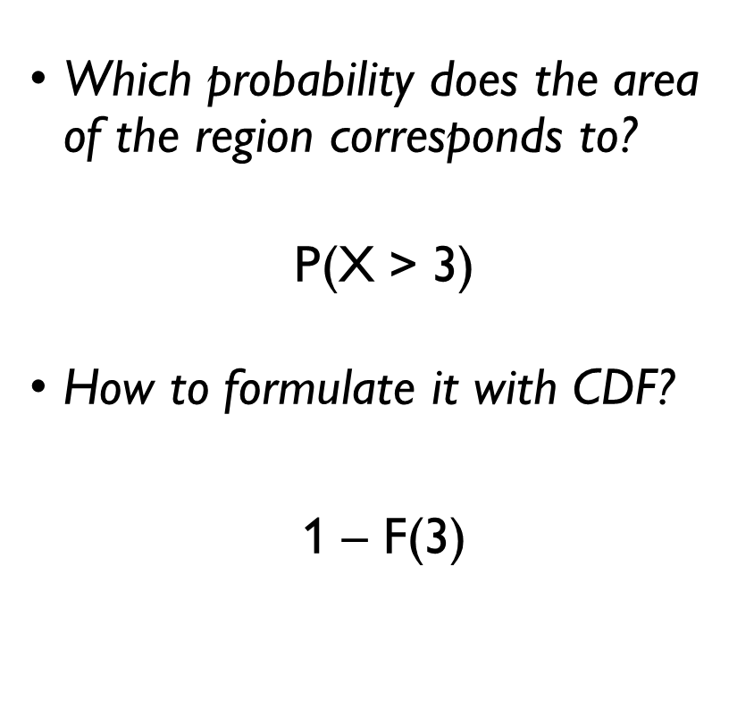
DENSITY: AREA UNDER THE CURVE
Which probability does the area of the region corresponds to?
P(X > 3)
How to formulate it with CDF?
1 – F(3)
= 1 - $\int_{−∞}^{3}{p\left(x\right)dx}$

Slide 55
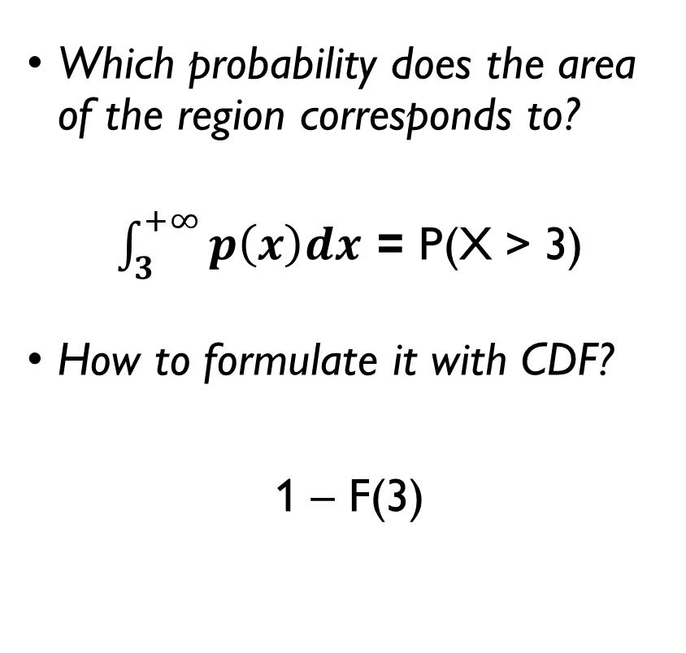
DENSITY: AREA UNDER THE CURVE
Which probability does the area of the region corresponds to?
$\int_{3}^{+∞}{p\left(x\right)dx}$ = P(X > 3)
How to formulate it with CDF?
1 – F(3)
= 1 - $\int_{−∞}^{3}{p\left(x\right)dx}$

Slide 56
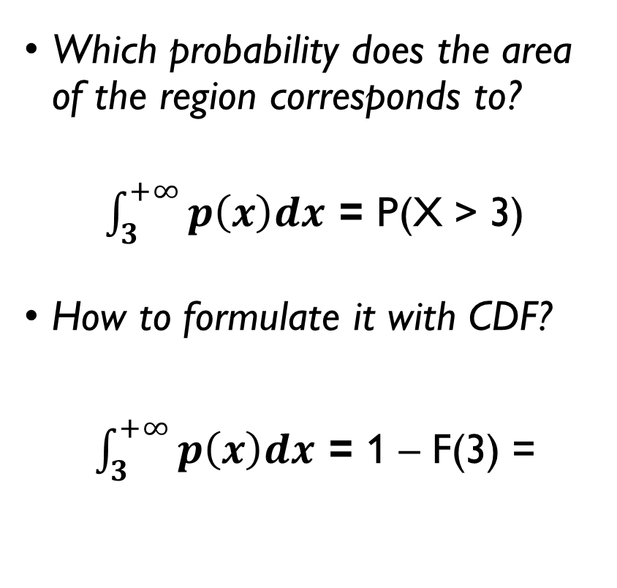
DENSITY: AREA UNDER THE CURVE
Which probability does the area of the region corresponds to?
$\int_{3}^{+∞}{p\left(x\right)dx}$ = P(X > 3)
How to formulate it with CDF?
$\int_{3}^{+∞}{p\left(x\right)dx}$ = 1 – F(3) =
= 1 - $\int_{−∞}^{3}{p\left(x\right)dx}$

Slide 57
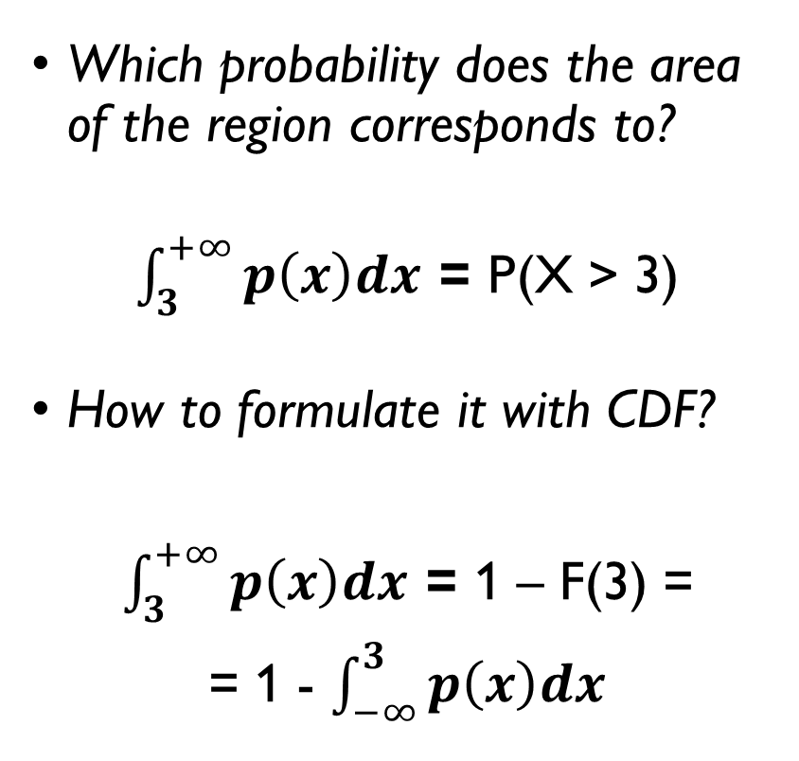
DENSITY: AREA UNDER THE CURVE
Which probability does the area of the region corresponds to?
$\int_{3}^{+∞}{p\left(x\right)dx}$ = P(X > 3)
How to formulate it with CDF?
$\int_{3}^{+∞}{p\left(x\right)dx}$ = 1 – F(3) =
= 1 - $\int_{−∞}^{3}{p\left(x\right)dx}$

Slide 58
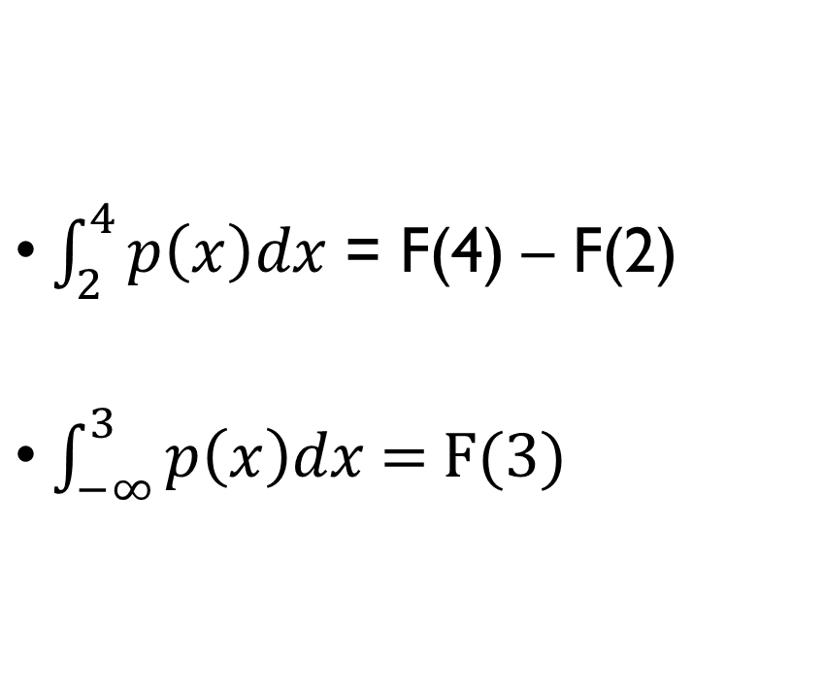
CDF AND PDF
$\int_{2}^{4}{p\left(x\right)dx}$ = F(4) – F(2)
$\int_{−∞}^{3}{p\left(x\right)dx}$= F(3)

Slide 59
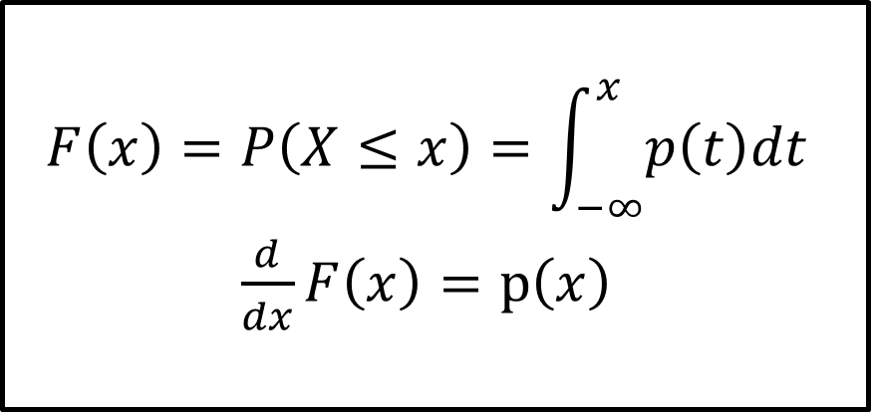
CDF AND PDF
$\int_{2}^{4}{p\left(x\right)dx}$ = F(4) – F(2)
$\int_{−∞}^{3}{p\left(x\right)dx}$= F(3)
$$F\left(x\right)=P\left(X≤x\right)=\int_{−∞}^{x}{p\left(t\right)dt}$$
$\frac{d}{dx}F\left(x\right)=p\left(x\right)$

Slide 60

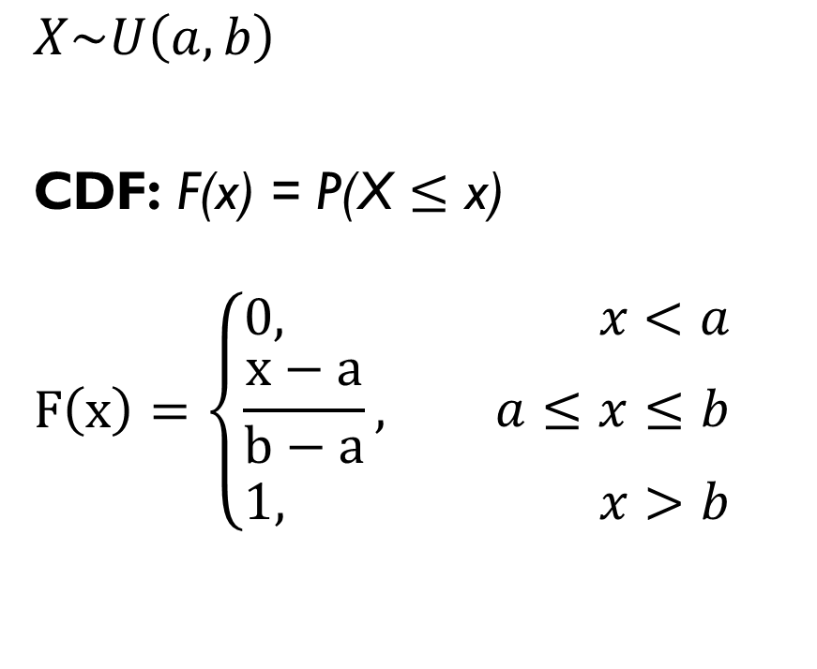
PDF OF THE UNIFORM DISTRIBUTION
$$X\sim U\left(a, b\right)$$
CDF: F(x) = P(X $≤$ x)
$$F\left(x\right)=\left\{\begin{aligned}0, x<a \\ \frac{x−a}{b−a}, a≤x≤b \\ 1, x>b\end{aligned}\right.$$
PDF:
$$p\left(x\right)=\left\{\begin{aligned}0, x≤a or x≥b \\ \frac{1}{b−a}, a<b<b\end{aligned}\right.$$

Slide 61
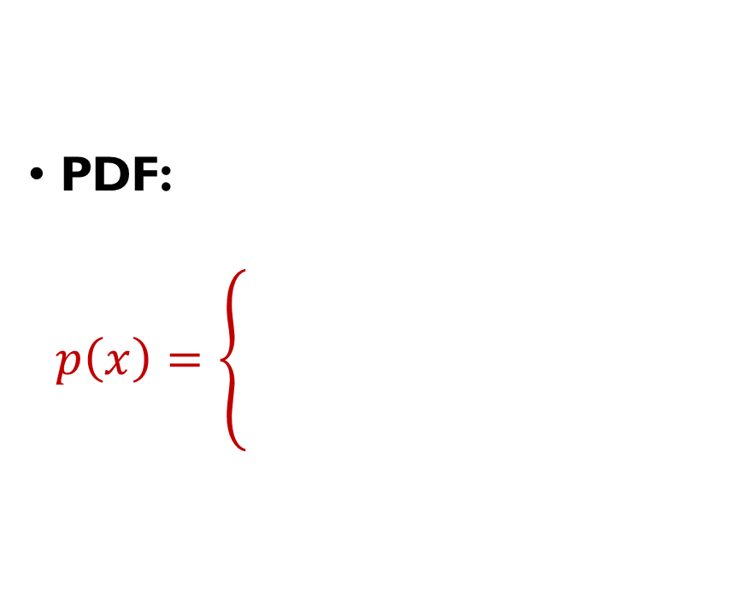
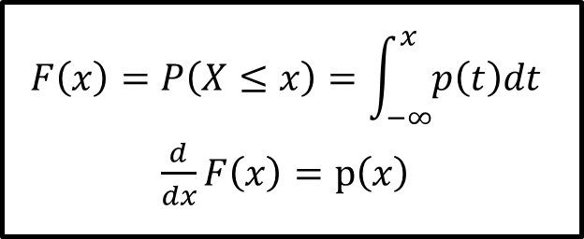
PDF OF THE UNIFORM DISTRIBUTION
$$X\sim U\left(a, b\right)$$
CDF: F(x) = P(X $≤$ x)
$$F\left(x\right)=\left\{\begin{aligned}0, x<a \\ \frac{x−a}{b−a}, a≤x≤b \\ 1, x>b\end{aligned}\right.$$
$$F\left(x\right)=P\left(X≤x\right)=\int_{−∞}^{x}{p\left(t\right)dt}$$
$\frac{d}{dx}F\left(x\right)=p\left(x\right)$
PDF:
$$p\left(x\right)=\left\{\begin{aligned}0, x≤a or x≥b \\ \frac{1}{b−a}, a<b<b\end{aligned}\right.$$

Slide 62
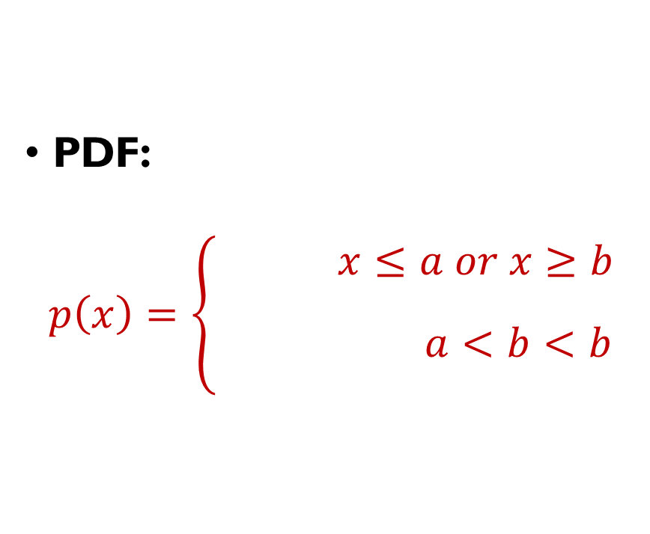
PDF OF THE UNIFORM DISTRIBUTION
$$X\sim U\left(a, b\right)$$
CDF: F(x) = P(X $≤$ x)
$$F\left(x\right)=\left\{\begin{aligned}0, x<a \\ \frac{x−a}{b−a}, a≤x≤b \\ 1, x>b\end{aligned}\right.$$
$$F\left(x\right)=P\left(X≤x\right)=\int_{−∞}^{x}{p\left(t\right)dt}$$
$\frac{d}{dx}F\left(x\right)=p\left(x\right)$
PDF:
$$p\left(x\right)=\left\{\begin{aligned}0, x≤a or x≥b \\ \frac{1}{b−a}, a<b<b\end{aligned}\right.$$

Slide 63
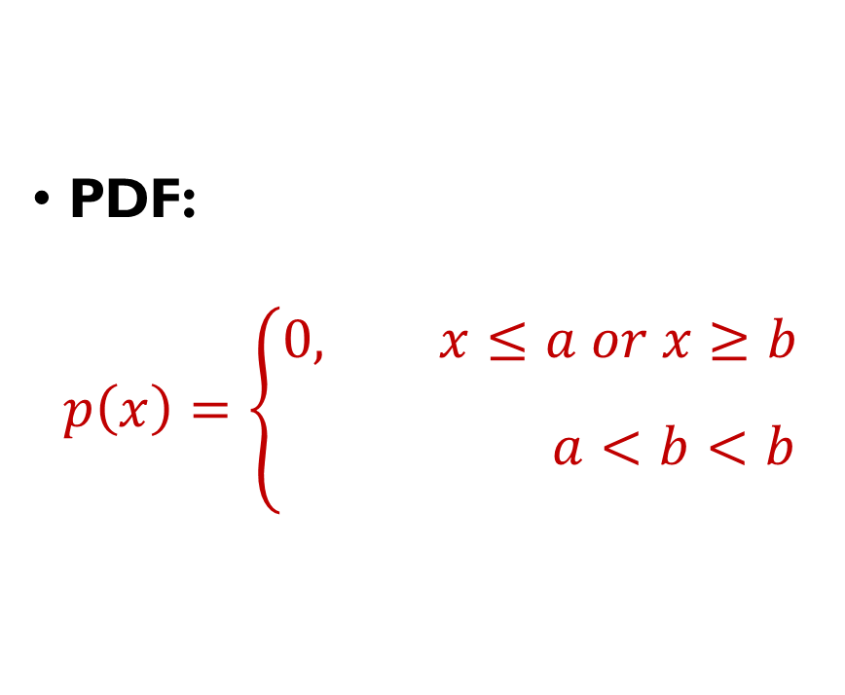
PDF OF THE UNIFORM DISTRIBUTION
$$X\sim U\left(a, b\right)$$
CDF: F(x) = P(X $≤$ x)
$$F\left(x\right)=\left\{\begin{aligned}0, x<a \\ \frac{x−a}{b−a}, a≤x≤b \\ 1, x>b\end{aligned}\right.$$
$$F\left(x\right)=P\left(X≤x\right)=\int_{−∞}^{x}{p\left(t\right)dt}$$
$\frac{d}{dx}F\left(x\right)=p\left(x\right)$
PDF:
$$p\left(x\right)=\left\{\begin{aligned}0, x≤a or x≥b \\ \frac{1}{b−a}, a<b<b\end{aligned}\right.$$

Slide 64
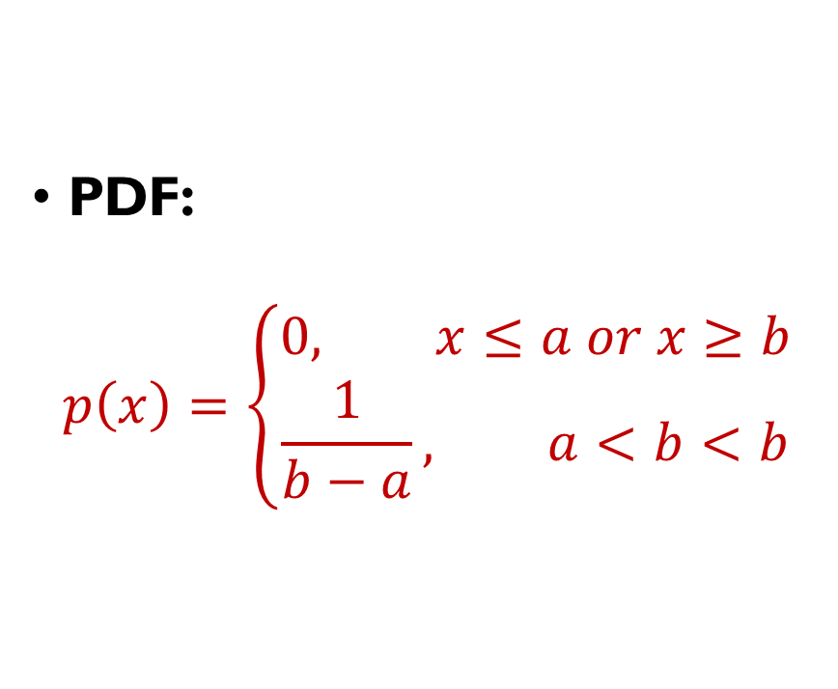
PDF OF THE UNIFORM DISTRIBUTION
$$X\sim U\left(a, b\right)$$
CDF: F(x) = P(X $≤$ x)
$$F\left(x\right)=\left\{\begin{aligned}0, x<a \\ \frac{x−a}{b−a}, a≤x≤b \\ 1, x>b\end{aligned}\right.$$
$$F\left(x\right)=P\left(X≤x\right)=\int_{−∞}^{x}{p\left(t\right)dt}$$
$\frac{d}{dx}F\left(x\right)=p\left(x\right)$
PDF:
$$p\left(x\right)=\left\{\begin{aligned}0, x≤a or x≥b \\ \frac{1}{b−a}, a<b<b\end{aligned}\right.$$

Slide 65
SHORT QUIZ
CDFs and PDFs

Slide 66
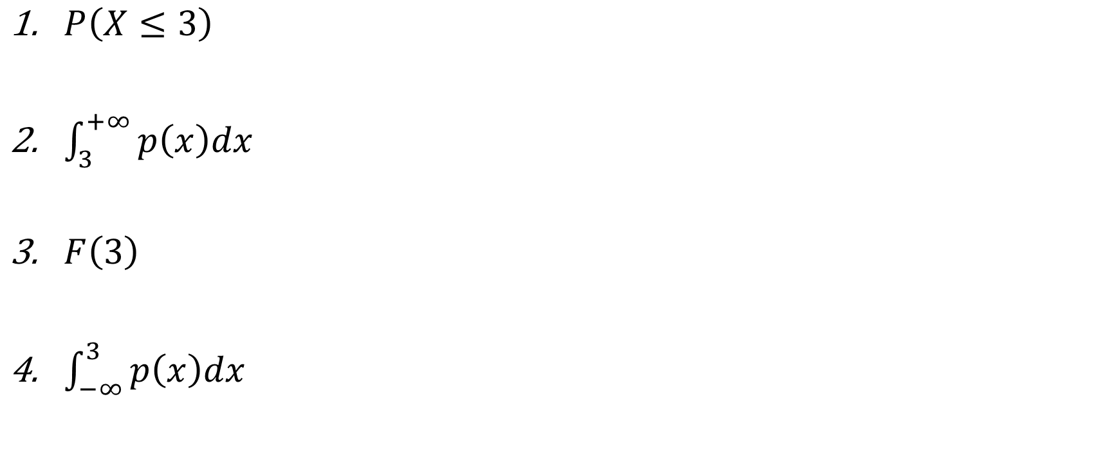
WHAT IS DIFFERENT FROM THE REST
$P\left(X≤3\right)$
$\int_{3}^{+∞}{p\left(x\right)dx}$
$F\left(3\right)$
$\int_{−∞}^{3}{p\left(x\right)dx}$

Slide 67

WHAT IS DIFFERENT FROM THE REST
$P\left(X≤3\right)$
$\int_{3}^{+∞}{p\left(x\right)dx}$
$F\left(3\right)$
$\int_{−∞}^{3}{p\left(x\right)dx}$

Slide 68

WHAT IS DIFFERENT FROM THE REST
$P\left(X>5\right)$
$\int_{5}^{+∞}{p\left(x\right)dx}$
$\int_{−∞}^{5}{p\left(x\right)dx}$
$1−F\left(5\right)$

Slide 69

WHAT IS DIFFERENT FROM THE REST
$P\left(X>5\right)$
$\int_{5}^{+∞}{p\left(x\right)dx}$
$\int_{−∞}^{5}{p\left(x\right)dx}$
$1−F\left(5\right)$

Slide 70

WHAT IS DIFFERENT FROM THE REST
$\int_{3}^{5}{p\left(x\right)dx}$
$P\left(3<X≤5\right)$
$F\left(3\right)−F\left(5\right)$
$\int_{−∞}^{5}{p\left(x\right)dx}−\int_{−∞}^{3}{p\left(x\right)dx}$

Slide 71

WHAT IS DIFFERENT FROM THE REST
$\int_{3}^{5}{p\left(x\right)dx}$
$P\left(3<X≤5\right)$
$F\left(3\right)−F\left(5\right)$
$\int_{−∞}^{5}{p\left(x\right)dx}−\int_{−∞}^{3}{p\left(x\right)dx}$

Slide 72
PROPERTIES OF CONTINUOUS RANDOM VARIABLES

Slide 73

UNIFORM DISTRIBUTION: WHAT WE KNOW SO FAR
$X\sim U\left(a, b\right)$
CDF:
$$F\left(x\right)=\left\{\begin{aligned}0, x<a \\ \frac{x−a}{b−a}, a≤x≤b \\ 1, x>b\end{aligned}\right.$$
PDF:
$$p\left(x\right)=\left\{\begin{aligned}0, x≤a or x≥b \\ \frac{1}{b−a}, a<b<b\end{aligned}\right.$$

Slide 74

UNIFORM DISTRIBUTION: WHAT WE KNOW SO FAR
$X\sim U\left(a, b\right)$
CDF:
$$F\left(x\right)=\left\{\begin{aligned}0, x<a \\ \frac{x−a}{b−a}, a≤x≤b \\ 1, x>b\end{aligned}\right.$$
PDF:
$$p\left(x\right)=\left\{\begin{aligned}0, x≤a or x≥b \\ \frac{1}{b−a}, a<b<b\end{aligned}\right.$$

Slide 75

UNIFORM DISTRIBUTION: WHAT WE KNOW SO FAR
$X\sim U\left(a, b\right)$
CDF:
$$F\left(x\right)=\left\{\begin{aligned}0, x<a \\ \frac{x−a}{b−a}, a≤x≤b \\ 1, x>b\end{aligned}\right.$$
PDF:
$$p\left(x\right)=\left\{\begin{aligned}0, x≤a or x≥b \\ \frac{1}{b−a}, a<b<b\end{aligned}\right.$$

Slide 76

UNIFORM DISTRIBUTION: WHAT WE KNOW SO FAR
$X\sim U\left(a, b\right)$
CDF:
$$F\left(x\right)=\left\{\begin{aligned}0, x<a \\ \frac{x−a}{b−a}, a≤x≤b \\ 1, x>b\end{aligned}\right.$$
PDF:
$$p\left(x\right)=\left\{\begin{aligned}0, x≤a or x≥b \\ \frac{1}{b−a}, a<b<b\end{aligned}\right.$$
$E\left(X\right)=\frac{\left(a+b\right)}{2}$
$Var\left(X\right)=$ ?
But how to compute expected value and variance of a continuous variable?
a
(a+b)/2
b

Slide 77

UNIFORM DISTRIBUTION: WHAT WE KNOW SO FAR
$X\sim U\left(a, b\right)$
CDF:
$$F\left(x\right)=\left\{\begin{aligned}0, x<a \\ \frac{x−a}{b−a}, a≤x≤b \\ 1, x>b\end{aligned}\right.$$
PDF:
$$p\left(x\right)=\left\{\begin{aligned}0, x≤a or x≥b \\ \frac{1}{b−a}, a<b<b\end{aligned}\right.$$
$E\left(X\right)=\frac{\left(a+b\right)}{2}$
$Var\left(X\right)=$ ?
But how to compute expected value and variance of a continuous variable?
a
(a+b)/2
b

Slide 78

UNIFORM DISTRIBUTION: WHAT WE KNOW SO FAR
$X\sim U\left(a, b\right)$
CDF:
$$F\left(x\right)=\left\{\begin{aligned}0, x<a \\ \frac{x−a}{b−a}, a≤x≤b \\ 1, x>b\end{aligned}\right.$$
PDF:
$$p\left(x\right)=\left\{\begin{aligned}0, x≤a or x≥b \\ \frac{1}{b−a}, a<b<b\end{aligned}\right.$$
$E\left(X\right)=\frac{\left(a+b\right)}{2}$
$Var\left(X\right)=$ ?
But how to compute expected value and variance of a continuous variable?
a
(a+b)/2
b

Slide 79


EXPECTED VALUE
DISCRETE RANDOM VARIABLE
CONTINUOUS RANDOM VARIABLE
Sum up all the values a random variable can take, multiplying them by their probabilities:
$$E\left(X\right)=\sum_{X_{i}}{X_{i}∙P\left(X=X_{i}\right)}$$
Same principle:
$$E\left(X\right)=\int_{−∞}^{+∞}{x∙p\left(x\right)dx}$$

Slide 80

EXPECTED VALUE
DISCRETE RANDOM VARIABLE
CONTINUOUS RANDOM VARIABLE
Sum up all the values a random variable can take, multiplying them by their probabilities:
$$E\left(X\right)=\sum_{X_{i}}{X_{i}∙P\left(X=X_{i}\right)}$$
Same principle:
$$E\left(X\right)=\int_{−∞}^{+∞}{x∙p\left(x\right)dx}$$

Slide 81

EXPECTED VALUE
DISCRETE RANDOM VARIABLE
CONTINUOUS RANDOM VARIABLE
Sum up all the values a random variable can take, multiplying them by their probabilities:
$$E\left(X\right)=\sum_{X_{i}}{X_{i}∙P\left(X=X_{i}\right)}$$
Same principle:
$$E\left(X\right)=\int_{−∞}^{+∞}{x∙p\left(x\right)dx}$$

Slide 82

EXPECTED VALUE
DISCRETE RANDOM VARIABLE
CONTINUOUS RANDOM VARIABLE
Sum up all the values a random variable can take, multiplying them by their probabilities:
$$E\left(X\right)=\sum_{X_{i}}{X_{i}∙P\left(X=X_{i}\right)}$$
Same principle:
$$E\left(X\right)=\int_{−∞}^{+∞}{x∙p\left(x\right)dx}$$

Slide 83


MEAN OF UNIFORM DISTRIBUTION
$$X\sim U\left(a, b\right)$$
$$p\left(x\right)=\left\{\begin{aligned}0, x≤a or x≥b \\ \frac{1}{b−a}, a<b<b\end{aligned}\right.$$
$$E\left(X\right)=\int_{−∞}^{+∞}{x∙p\left(x\right)dx}=$$
$$=\int_{a}^{b}{x∙\frac{1}{b−a}dx}=$$
$$=\frac{1}{b−a}∙\frac{b^{2}−a^{2}}{2}=\frac{a+b}{2}$$

Slide 84

MEAN OF UNIFORM DISTRIBUTION
$$X\sim U\left(a, b\right)$$
$$p\left(x\right)=\left\{\begin{aligned}0, x≤a or x≥b \\ \frac{1}{b−a}, a<b<b\end{aligned}\right.$$
$$E\left(X\right)=\int_{−∞}^{+∞}{x∙p\left(x\right)dx}=$$
$$=\int_{a}^{b}{x∙\frac{1}{b−a}dx}=$$
$$=\frac{1}{b−a}∙\frac{b^{2}−a^{2}}{2}=\frac{a+b}{2}$$

Slide 85

MEAN OF UNIFORM DISTRIBUTION
$$X\sim U\left(a, b\right)$$
$$p\left(x\right)=\left\{\begin{aligned}0, x≤a or x≥b \\ \frac{1}{b−a}, a<b<b\end{aligned}\right.$$
$$E\left(X\right)=\int_{−∞}^{+∞}{x∙p\left(x\right)dx}=$$
$$=\int_{a}^{b}{x∙\frac{1}{b−a}dx}=$$
$$=\frac{1}{b−a}∙\frac{b^{2}−a^{2}}{2}=\frac{a+b}{2}$$

Slide 86

MEAN OF UNIFORM DISTRIBUTION
$$X\sim U\left(a, b\right)$$
$$p\left(x\right)=\left\{\begin{aligned}0, x≤a or x≥b \\ \frac{1}{b−a}, a<b<b\end{aligned}\right.$$
$$E\left(X\right)=\int_{−∞}^{+∞}{x∙p\left(x\right)dx}=$$
$$=\int_{a}^{b}{x∙\frac{1}{b−a}dx}=$$
$$=\frac{1}{b−a}∙\frac{b^{2}−a^{2}}{2}=\frac{a+b}{2}$$

Slide 87

MEAN OF UNIFORM DISTRIBUTION
$$X\sim U\left(a, b\right)$$
$$p\left(x\right)=\left\{\begin{aligned}0, x≤a or x≥b \\ \frac{1}{b−a}, a<b<b\end{aligned}\right.$$
$$E\left(X\right)=\int_{−∞}^{+∞}{x∙p\left(x\right)dx}=$$
$$=\int_{a}^{b}{x∙\frac{1}{b−a}dx}=$$
$$=\frac{1}{b−a}∙\frac{b^{2}−a^{2}}{2}=\frac{a+b}{2}$$

Slide 88

MEAN OF UNIFORM DISTRIBUTION
Imagine that $X\sim U\left(0, 10\right)$
$E\left(X\right)=\frac{10+0}{2}=5$
$E\left(X−1\right)=E\left(X\right)−1=5$
$E\left(2∙X\right)=2∙E\left(X\right)=10$
$E\left(X^{2}\right)= \int_{0}^{10}{x^{2}∙\frac{1}{10}dx}=\frac{1}{10}∙\frac{{10}^{3}}{3}=\frac{100}{3}$

Slide 89

MEAN OF UNIFORM DISTRIBUTION
Imagine that $X\sim U\left(0, 10\right)$
$E\left(X\right)=\frac{10+0}{2}=5$
$E\left(X−1\right)=E\left(X\right)−1=5$
$E\left(2∙X\right)=2∙E\left(X\right)=10$
$E\left(X^{2}\right)= \int_{0}^{10}{x^{2}∙\frac{1}{10}dx}=\frac{1}{10}∙\frac{{10}^{3}}{3}=\frac{100}{3}$

Slide 90

MEAN OF UNIFORM DISTRIBUTION
Imagine that $X\sim U\left(0, 10\right)$
$E\left(X\right)=\frac{10+0}{2}=5$
$E\left(X−1\right)=E\left(X\right)−1=5$
$E\left(2∙X\right)=2∙E\left(X\right)=10$
$E\left(X^{2}\right)= \int_{0}^{10}{x^{2}∙\frac{1}{10}dx}=\frac{1}{10}∙\frac{{10}^{3}}{3}=\frac{100}{3}$

Slide 91

MEAN OF UNIFORM DISTRIBUTION
Imagine that $X\sim U\left(0, 10\right)$
$E\left(X\right)=\frac{10+0}{2}=5$
$E\left(X−1\right)=E\left(X\right)−1=5$
$E\left(2∙X\right)=2∙E\left(X\right)=10$
$E\left(X^{2}\right)= \int_{0}^{10}{x^{2}∙\frac{1}{10}dx}=\frac{1}{10}∙\frac{{10}^{3}}{3}=\frac{100}{3}$

Slide 92

MEAN OF UNIFORM DISTRIBUTION
Imagine that $X\sim U\left(0, 10\right)$
$E\left(X\right)=\frac{10+0}{2}=5$
$E\left(X−1\right)=E\left(X\right)−1=5$
$E\left(2∙X\right)=2∙E\left(X\right)=10$
$E\left(X^{2}\right)= \int_{0}^{10}{x^{2}∙\frac{1}{10}dx}=\frac{1}{10}∙\frac{{10}^{3}}{3}=\frac{100}{3}$

Slide 93

MEAN OF UNIFORM DISTRIBUTION
Imagine that $X\sim U\left(0, 10\right)$
$E\left(X\right)=\frac{10+0}{2}=5$
$E\left(X−1\right)=E\left(X\right)−1=4$
$E\left(2∙X\right)=2∙E\left(X\right)=10$
$E\left(X^{2}\right)= \int_{0}^{10}{x^{2}∙\frac{1}{10}dx}=\frac{1}{10}∙\frac{{10}^{3}}{3}=\frac{100}{3}$

Slide 94

MEAN OF UNIFORM DISTRIBUTION
Imagine that $X\sim U\left(0, 10\right)$
$E\left(X\right)=\frac{10+0}{2}=5$
$E\left(X−1\right)=E\left(X\right)−1=5$
$E\left(2∙X\right)=2∙E\left(X\right)=10$
$E\left(X^{2}\right)= \int_{0}^{10}{x^{2}∙\frac{1}{10}dx}=\frac{1}{10}∙\frac{{10}^{3}}{3}=\frac{100}{3}$

Slide 95

MEAN OF UNIFORM DISTRIBUTION
Imagine that $X\sim U\left(0, 10\right)$
$E\left(X\right)=\frac{10+0}{2}=5$
$E\left(X−1\right)=E\left(X\right)−1=5$
$E\left(2∙X\right)=2∙E\left(X\right)=10$
$E\left(X^{2}\right)= \int_{0}^{10}{x^{2}∙\frac{1}{10}dx}=\frac{1}{10}∙\frac{{10}^{3}}{3}=\frac{100}{3}$
To compute mean of some f(X):
$$E\left(f\left(X\right)\right)=\int_{−∞}^{+∞}{f\left(x\right)∙p\left(x\right)dx}$$

Slide 96

MEAN OF UNIFORM DISTRIBUTION
Imagine that $X\sim U\left(0, 10\right)$
$E\left(X\right)=\frac{10+0}{2}=5$
$E\left(X−1\right)=E\left(X\right)−1=5$
$E\left(2∙X\right)=2∙E\left(X\right)=10$
$E\left(X^{2}\right)= \int_{0}^{10}{x^{2}∙\frac{1}{10}dx}=\frac{1}{10}∙\frac{{10}^{3}}{3}=\frac{100}{3}$
To compute mean of some f(X):
$$E\left(f\left(X\right)\right)=\int_{−∞}^{+∞}{f\left(x\right)∙p\left(x\right)dx}$$

Slide 97

MEAN OF UNIFORM DISTRIBUTION
Imagine that $X\sim U\left(0, 10\right)$
$E\left(X\right)=\frac{10+0}{2}=5$
$E\left(X−1\right)=E\left(X\right)−1=5$
$E\left(2∙X\right)=2∙E\left(X\right)=10$
$E\left(X^{2}\right)= \int_{0}^{10}{x^{2}∙\frac{1}{10}dx}=\frac{1}{10}∙\frac{{10}^{3}}{3}=\frac{100}{3}$
To compute mean of some f(X):
$$E\left(f\left(X\right)\right)=\int_{−∞}^{+∞}{f\left(x\right)∙p\left(x\right)dx}$$

Slide 98

MEAN OF UNIFORM DISTRIBUTION
Imagine that $X\sim U\left(0, 10\right)$
$E\left(X\right)=\frac{10+0}{2}=5$
$E\left(X−1\right)=E\left(X\right)−1=5$
$E\left(2∙X\right)=2∙E\left(X\right)=10$
$E\left(X^{2}\right)= \int_{0}^{10}{x^{2}∙\frac{1}{10}dx}=\frac{1}{10}∙\frac{{10}^{3}}{3}=\frac{100}{3}$
To compute mean of some f(X):
$$E\left(f\left(X\right)\right)=\int_{−∞}^{+∞}{f\left(x\right)∙p\left(x\right)dx}$$

Slide 99

VARIANCE
DISCRETE RANDOM VARIABLE
CONTINUOUS RANDOM VARIABLE
Expected squared distance between a value and the mean:
$$Var\left(X\right)=E\left({\left(X −E\left(X\right)\right)}^{2}\right)==E\left(X^{2}\right)−{\left(E\left(X\right)\right)}^{2}$$
E.g., for Bernoulli
Var(X) = p – p² = p(1-p)
Same principle

Slide 100

VARIANCE
DISCRETE RANDOM VARIABLE
CONTINUOUS RANDOM VARIABLE
Expected squared distance between a value and the mean:
$$Var\left(X\right)=E\left({\left(X −E\left(X\right)\right)}^{2}\right)==E\left(X^{2}\right)−{\left(E\left(X\right)\right)}^{2}$$
E.g., for Bernoulli
Var(X) = p – p² = p(1-p)
Same principle

Slide 101

VARIANCE
DISCRETE RANDOM VARIABLE
CONTINUOUS RANDOM VARIABLE
Expected squared distance between a value and the mean:
$$Var\left(X\right)=E\left({\left(X −E\left(X\right)\right)}^{2}\right)==E\left(X^{2}\right)−{\left(E\left(X\right)\right)}^{2}$$
E.g., for Bernoulli
Var(X) = p – p² = p(1-p)
Same principle

Slide 102

VARIANCE
DISCRETE RANDOM VARIABLE
CONTINUOUS RANDOM VARIABLE
Expected squared distance between a value and the mean:
$$Var\left(X\right)=E\left({\left(X −E\left(X\right)\right)}^{2}\right)==E\left(X^{2}\right)−{\left(E\left(X\right)\right)}^{2}$$
E.g., for Bernoulli
Var(X) = p – p² = p(1-p)
Same principle

Slide 103
VARIANCE
DISCRETE RANDOM VARIABLE
CONTINUOUS RANDOM VARIABLE
Expected squared distance between a value and the mean:
$$Var\left(X\right)=E\left({\left(X −E\left(X\right)\right)}^{2}\right)==E\left(X^{2}\right)−{\left(E\left(X\right)\right)}^{2}$$
E.g., for Bernoulli
Var(X) = p – p² = p(1-p)
Same principle.
X ~ U(a, b), Var(X) = ?

Slide 104
VARIANCE
DISCRETE RANDOM VARIABLE
CONTINUOUS RANDOM VARIABLE
Expected squared distance between a value and the mean:
$$Var\left(X\right)=E\left({\left(X −E\left(X\right)\right)}^{2}\right)==E\left(X^{2}\right)−{\left(E\left(X\right)\right)}^{2}$$
E.g., for Bernoulli
Var(X) = p – p² = p(1-p)
Same principle.
X ~ U(a, b), Var(X) = ?

Slide 105

VARIANCE OF A UNIFORM DISTRIBUTION
$X\sim U\left(a,b\right)$
$E\left(X\right)=\frac{a+b}{2}$
$Var\left(X\right)=E\left({\left(X −E\left(X\right)\right)}^{2}\right)=E\left(X^{2}\right)−{\left(E\left(X\right)\right)}^{2}$
$Var\left(X\right)={E\left(X^{2}\right)−\left(\frac{a+b}{2}\right)}^{2}=\frac{b^{3}−a^{3}}{3}−\frac{{\left(a+b\right)}^{2}}{4}=\frac{{\left(a−b\right)}^{2}}{12}$

Slide 106

VARIANCE OF A UNIFORM DISTRIBUTION
$X\sim U\left(a,b\right)$
$E\left(X\right)=\frac{a+b}{2}$
$Var\left(X\right)=E\left({\left(X −E\left(X\right)\right)}^{2}\right)=E\left(X^{2}\right)−{\left(E\left(X\right)\right)}^{2}$
$Var\left(X\right)={E\left(X^{2}\right)−\left(\frac{a+b}{2}\right)}^{2}=\frac{b^{3}−a^{3}}{3}−\frac{{\left(a+b\right)}^{2}}{4}=\frac{{\left(a−b\right)}^{2}}{12}$

Slide 107

VARIANCE OF A UNIFORM DISTRIBUTION
$X\sim U\left(a,b\right)$
$E\left(X\right)=\frac{a+b}{2}$
$Var\left(X\right)=E\left({\left(X −E\left(X\right)\right)}^{2}\right)=E\left(X^{2}\right)−{\left(E\left(X\right)\right)}^{2}$
$Var\left(X\right)={E\left(X^{2}\right)−\left(\frac{a+b}{2}\right)}^{2}=\frac{b^{3}−a^{3}}{3}−\frac{{\left(a+b\right)}^{2}}{4}=\frac{{\left(a−b\right)}^{2}}{12}$

Slide 108

VARIANCE OF A UNIFORM DISTRIBUTION
$X\sim U\left(a,b\right)$
$E\left(X\right)=\frac{a+b}{2}$
$Var\left(X\right)=E\left({\left(X −E\left(X\right)\right)}^{2}\right)=E\left(X^{2}\right)−{\left(E\left(X\right)\right)}^{2}$
$Var\left(X\right)={E\left(X^{2}\right)−\left(\frac{a+b}{2}\right)}^{2}=\frac{b^{3}−a^{3}}{3}−\frac{{\left(a+b\right)}^{2}}{4}=\frac{{\left(a−b\right)}^{2}}{12}$

Slide 109

VARIANCE OF A UNIFORM DISTRIBUTION
$X\sim U\left(a,b\right)$
$E\left(X\right)=\frac{a+b}{2}$
$Var\left(X\right)=E\left({\left(X −E\left(X\right)\right)}^{2}\right)=E\left(X^{2}\right)−{\left(E\left(X\right)\right)}^{2}$
$Var\left(X\right)={E\left(X^{2}\right)−\left(\frac{a+b}{2}\right)}^{2}=\frac{b^{3}−a^{3}}{3}−\frac{{\left(a+b\right)}^{2}}{4}=\frac{{\left(a−b\right)}^{2}}{12}$

Slide 110


UNIFORM DISTRIBUTION
$X\sim U\left(a, b\right)$
CDF:
$$F\left(x\right)=\left\{\begin{aligned}0, x<a \\ \frac{x−a}{b−a}, a≤x≤b \\ 1, x>b\end{aligned}\right.$$
PDF:
$$p\left(x\right)=\left\{\begin{aligned}0, x≤a or x≥b \\ \frac{1}{b−a}, a<b<b\end{aligned}\right.$$
MEAN:
$$E\left(X\right)=\frac{\left(a+b\right)}{2}$$
VARIANCE:
$Var\left(X\right)=\frac{{\left(a−b\right)}^{2}}{12}$

Slide 111


UNIFORM DISTRIBUTION
EXAMPLE: $X \sim U\left(0, 1\right)$
$$F\left(x\right)=\left\{\begin{aligned}0, x<0 \\ x, 0≤x≤1 \\ 1, x>1\end{aligned}\right.$$
$$p\left(x\right)=\left\{\begin{aligned}0, x≤0 or x≥1 \\ 1, 0<x<1\end{aligned}\right.$$
$$E\left(X\right)=\frac{1−0}{2}=0.5$$
$$Var\left(X\right)=\frac{{\left(1−0\right)}^{2}}{12}=\frac{1}{12}$$

Slide 112

UNIFORM DISTRIBUTION
EXAMPLE: $X \sim U\left(0, 1\right)$
$$F\left(x\right)=\left\{\begin{aligned}0, x<0 \\ x, 0≤x≤1 \\ 1, x>1\end{aligned}\right.$$
$$p\left(x\right)=\left\{\begin{aligned}0, x≤0 or x≥1 \\ 1, 0<x<1\end{aligned}\right.$$
$$E\left(X\right)=\frac{1−0}{2}=0.5$$
$$Var\left(X\right)=\frac{{\left(1−0\right)}^{2}}{12}=\frac{1}{12}$$

Slide 113

UNIFORM DISTRIBUTION
EXAMPLE: $X \sim U\left(0, 1\right)$
$$F\left(x\right)=\left\{\begin{aligned}0, x<0 \\ x, 0≤x≤1 \\ 1, x>1\end{aligned}\right.$$
$$p\left(x\right)=\left\{\begin{aligned}0, x≤0 or x≥1 \\ 1, 0<x<1\end{aligned}\right.$$
$$E\left(X\right)=\frac{1−0}{2}=0.5$$
$$Var\left(X\right)=\frac{{\left(1−0\right)}^{2}}{12}=\frac{1}{12}$$

Slide 114

UNIFORM DISTRIBUTION
EXAMPLE: $X \sim U\left(0, 1\right)$
$$F\left(x\right)=\left\{\begin{aligned}0, x<0 \\ x, 0≤x≤1 \\ 1, x>1\end{aligned}\right.$$
$$p\left(x\right)=\left\{\begin{aligned}0, x≤0 or x≥1 \\ 1, 0<x<1\end{aligned}\right.$$
$$E\left(X\right)=\frac{1−0}{2}=0.5$$
$$Var\left(X\right)=\frac{{\left(1−0\right)}^{2}}{12}=\frac{1}{12}$$

Slide 115

UNIFORM DISTRIBUTION
EXAMPLE: $X \sim U\left(0, 1\right)$
$$F\left(x\right)=\left\{\begin{aligned}0, x<0 \\ x, 0≤x≤1 \\ 1, x>1\end{aligned}\right.$$
$$p\left(x\right)=\left\{\begin{aligned}0, x≤0 or x≥1 \\ 1, 0<x<1\end{aligned}\right.$$
$$E\left(X\right)=\frac{1−0}{2}=0.5$$
$$Var\left(X\right)=\frac{{\left(1−0\right)}^{2}}{12}=\frac{1}{12}$$

Slide 116

UNIFORM DISTRIBUTION
EXAMPLE: $X \sim U\left(0, 1\right)$
$$F\left(x\right)=\left\{\begin{aligned}0, x<0 \\ x, 0≤x≤1 \\ 1, x>1\end{aligned}\right.$$
$$p\left(x\right)=\left\{\begin{aligned}0, x≤0 or x≥1 \\ 1, 0<x<1\end{aligned}\right.$$
$$E\left(X\right)=\frac{1−0}{2}=0.5$$
$$Var\left(X\right)=\frac{{\left(1−0\right)}^{2}}{12}=\frac{1}{12}$$

Slide 117

UNIFORM DISTRIBUTION
EXAMPLE: $X \sim U\left(0, 1\right)$
$$F\left(x\right)=\left\{\begin{aligned}0, x<0 \\ x, 0≤x≤1 \\ 1, x>1\end{aligned}\right.$$
$$p\left(x\right)=\left\{\begin{aligned}0, x≤0 or x≥1 \\ 1, 0<x<1\end{aligned}\right.$$
$$E\left(X\right)=\frac{1−0}{2}=0.5$$
$$Var\left(X\right)=\frac{{\left(1−0\right)}^{2}}{12}=\frac{1}{12}$$

Slide 118
EXPONENTIAL DISTRIBUTION

Slide 119
EXPONENTIAL DISTRIBUTION
Poisson distribution (discrete): #of events that occur in a given period of time. # of phone calls received every hour
Exponential distribution (continuous): time between two Poisson events. Time between the two phone calls

Slide 120
EXPONENTIAL DISTRIBUTION
Poisson distribution (discrete): #of events that occur in a given period of time. # of phone calls received every hour
Exponential distribution (continuous): time between two Poisson events. Time between the two phone calls

Slide 121
EXPONENTIAL DISTRIBUTION
Poisson distribution (discrete): #of events that occur in a given period of time. # of phone calls received every hour
Exponential distribution (continuous): time between two Poisson events. Time between the two phone calls

Slide 122
EXPONENTIAL DISTRIBUTION
Poisson distribution (discrete): #of events that occur in a given period of time. # of phone calls received every hour
Exponential distribution (continuous): time between two Poisson events. Time between the two phone calls

Slide 123

EXPONENTIAL DISTRIBUTION
$X \sim Exp\left(λ\right)$, $λ>0$ – rate parameter.
CDF:
$$F\left(x\right)=\left\{\begin{aligned}1 − e^{−λx}, x≥0 \\ 0, x<0\end{aligned}\right.$$
PDF:
$$p\left(x\right)=\left\{\begin{aligned}λ∙e^{−λx}, x≥0 \\ 0, x<0\end{aligned}\right.$$

Slide 124


EXPONENTIAL DISTRIBUTION
$$F\left(x\right)=P\left(X≤x\right)=\int_{−∞}^{x}{p\left(t\right)dt}$$
$\frac{d}{dx}F\left(x\right)=p\left(x\right)$
$X \sim Exp\left(λ\right)$, $λ>0$ – rate parameter.
CDF:
$$F\left(x\right)=\left\{\begin{aligned}1 − e^{−λx}, x≥0 \\ 0, x<0\end{aligned}\right.$$
PDF:
$$p\left(x\right)=\left\{\begin{aligned}λ∙e^{−λx}, x≥0 \\ 0, x<0\end{aligned}\right.$$

Slide 125

EXPONENTIAL DISTRIBUTION
$$F\left(x\right)=P\left(X≤x\right)=\int_{−∞}^{x}{p\left(t\right)dt}$$
$\frac{d}{dx}F\left(x\right)=p\left(x\right)$
$X \sim Exp\left(λ\right)$, $λ>0$ – rate parameter.
CDF:
$$F\left(x\right)=\left\{\begin{aligned}1 − e^{−λx}, x≥0 \\ 0, x<0\end{aligned}\right.$$
PDF:
$$p\left(x\right)=\left\{\begin{aligned}λ∙e^{−λx}, x≥0 \\ 0, x<0\end{aligned}\right.$$

Slide 126

EXPONENTIAL DISTRIBUTION
$$F\left(x\right)=P\left(X≤x\right)=\int_{−∞}^{x}{p\left(t\right)dt}$$
$\frac{d}{dx}F\left(x\right)=p\left(x\right)$
$X \sim Exp\left(λ\right)$, $λ>0$ – rate parameter.
CDF:
$$F\left(x\right)=\left\{\begin{aligned}1 − e^{−λx}, x≥0 \\ 0, x<0\end{aligned}\right.$$
PDF:
$$p\left(x\right)=\left\{\begin{aligned}λ∙e^{−λx}, x≥0 \\ 0, x<0\end{aligned}\right.$$

Slide 127

EXPONENTIAL DISTRIBUTION
$X \sim Exp\left(λ\right)$, $λ>0$ – rate parameter.
MEAN:
$$E\left(X\right)=\int_{−∞}^{+∞}{x∙p\left(x\right)dx}=\int_{0}^{+∞}{x∙{λe}^{−λx}dx}=\frac{1}{λ}$$
VARIANCE:
$$E\left(X^{2}\right)=\int_{−∞}^{+∞}{x^{2}∙p\left(x\right)dx}=\int_{0}^{+∞}{x^{2}∙{λe}^{−λx}dx}=\frac{2}{λ^{2}}$$
$$Var \left(X\right)=E\left(X^{2}\right)−{\left(E\left(X\right)\right)}^{2}=\frac{1}{λ^{2}}$$

Slide 128

EXPONENTIAL DISTRIBUTION
$X \sim Exp\left(λ\right)$, $λ>0$ – rate parameter.
MEAN:
$$E\left(X\right)=\int_{−∞}^{+∞}{x∙p\left(x\right)dx}=\int_{0}^{+∞}{x∙{λe}^{−λx}dx}=\frac{1}{λ}$$
VARIANCE:
$$E\left(X^{2}\right)=\int_{−∞}^{+∞}{x^{2}∙p\left(x\right)dx}=\int_{0}^{+∞}{x^{2}∙{λe}^{−λx}dx}=\frac{2}{λ^{2}}$$
$$Var \left(X\right)=E\left(X^{2}\right)−{\left(E\left(X\right)\right)}^{2}=\frac{1}{λ^{2}}$$

Slide 129

EXPONENTIAL DISTRIBUTION
$X \sim Exp\left(λ\right)$, $λ>0$ – rate parameter.
MEAN:
$$E\left(X\right)=\int_{−∞}^{+∞}{x∙p\left(x\right)dx}=\int_{0}^{+∞}{x∙{λe}^{−λx}dx}=\frac{1}{λ}$$
VARIANCE:
$$E\left(X^{2}\right)=\int_{−∞}^{+∞}{x^{2}∙p\left(x\right)dx}=\int_{0}^{+∞}{x^{2}∙{λe}^{−λx}dx}=\frac{2}{λ^{2}}$$
$$Var \left(X\right)=E\left(X^{2}\right)−{\left(E\left(X\right)\right)}^{2}=\frac{1}{λ^{2}}$$

Slide 130

EXPONENTIAL DISTRIBUTION
$X \sim Exp\left(λ\right)$, $λ>0$ – rate parameter.
MEAN:
$$E\left(X\right)=\int_{−∞}^{+∞}{x∙p\left(x\right)dx}=\int_{0}^{+∞}{x∙{λe}^{−λx}dx}=\frac{1}{λ}$$
VARIANCE:
$$E\left(X^{2}\right)=\int_{−∞}^{+∞}{x^{2}∙p\left(x\right)dx}=\int_{0}^{+∞}{x^{2}∙{λe}^{−λx}dx}=\frac{2}{λ^{2}}$$
$$Var \left(X\right)=E\left(X^{2}\right)−{\left(E\left(X\right)\right)}^{2}=\frac{1}{λ^{2}}$$

Slide 131

EXPONENTIAL DISTRIBUTION
$X \sim Exp\left(λ\right)$, $λ>0$ – rate parameter.
MEAN:
$$E\left(X\right)=\int_{−∞}^{+∞}{x∙p\left(x\right)dx}=\int_{0}^{+∞}{x∙{λe}^{−λx}dx}=\frac{1}{λ}$$
VARIANCE:
$$E\left(X^{2}\right)=\int_{−∞}^{+∞}{x^{2}∙p\left(x\right)dx}=\int_{0}^{+∞}{x^{2}∙{λe}^{−λx}dx}=\frac{2}{λ^{2}}$$
$$Var \left(X\right)=E\left(X^{2}\right)−{\left(E\left(X\right)\right)}^{2}=\frac{1}{λ^{2}}$$

Slide 132

EXPONENTIAL DISTRIBUTION
$X \sim Exp\left(λ\right)$, $λ>0$ – rate parameter.
MEAN:
$$E\left(X\right)=\int_{−∞}^{+∞}{x∙p\left(x\right)dx}=\int_{0}^{+∞}{x∙{λe}^{−λx}dx}=\frac{1}{λ}$$
VARIANCE:
$$E\left(X^{2}\right)=\int_{−∞}^{+∞}{x^{2}∙p\left(x\right)dx}=\int_{0}^{+∞}{x^{2}∙{λe}^{−λx}dx}=\frac{2}{λ^{2}}$$
$$Var \left(X\right)=E\left(X^{2}\right)−{\left(E\left(X\right)\right)}^{2}=\frac{1}{λ^{2}}$$

Slide 133

EXPONENTIAL DISTRIBUTION
$X \sim Exp\left(λ\right)$, $λ>0$ – rate parameter.
MEAN:
$$E\left(X\right)=\int_{−∞}^{+∞}{x∙p\left(x\right)dx}=\int_{0}^{+∞}{x∙{λe}^{−λx}dx}=\frac{1}{λ}$$
VARIANCE:
$$E\left(X^{2}\right)=\int_{−∞}^{+∞}{x^{2}∙p\left(x\right)dx}=\int_{0}^{+∞}{x^{2}∙{λe}^{−λx}dx}=\frac{2}{λ^{2}}$$
$$Var \left(X\right)=E\left(X^{2}\right)−{\left(E\left(X\right)\right)}^{2}=\frac{1}{λ^{2}}$$

Slide 134

EXPONENTIAL DISTRIBUTION
$X \sim Exp\left(λ\right)$, $λ>0$ – rate parameter.
MEAN:
$$E\left(X\right)=\int_{−∞}^{+∞}{x∙p\left(x\right)dx}=\int_{0}^{+∞}{x∙{λe}^{−λx}dx}=\frac{1}{λ}$$
VARIANCE:
$$E\left(X^{2}\right)=\int_{−∞}^{+∞}{x^{2}∙p\left(x\right)dx}=\int_{0}^{+∞}{x^{2}∙{λe}^{−λx}dx}=\frac{2}{λ^{2}}$$
$$Var \left(X\right)=E\left(X^{2}\right)−{\left(E\left(X\right)\right)}^{2}=\frac{1}{λ^{2}}$$

Slide 135

EXPONENTIAL DISTRIBUTION
$X \sim Exp\left(λ\right)$, $λ>0$ – rate parameter.
MEAN:
$$E\left(X\right)=\int_{−∞}^{+∞}{x∙p\left(x\right)dx}=\int_{0}^{+∞}{x∙{λe}^{−λx}dx}=\frac{1}{λ}$$
VARIANCE:
$$E\left(X^{2}\right)=\int_{−∞}^{+∞}{x^{2}∙p\left(x\right)dx}=\int_{0}^{+∞}{x^{2}∙{λe}^{−λx}dx}=\frac{2}{λ^{2}}$$
$$Var \left(X\right)=E\left(X^{2}\right)−{\left(E\left(X\right)\right)}^{2}=\frac{1}{λ^{2}}$$

Slide 136

EXPONENTIAL DISTRIBUTION
$X \sim Exp\left(λ\right)$, $λ>0$ – rate parameter.
MEAN:
$$E\left(X\right)=\int_{−∞}^{+∞}{x∙p\left(x\right)dx}=\int_{0}^{+∞}{x∙{λe}^{−λx}dx}=\frac{1}{λ}$$
VARIANCE:
$$E\left(X^{2}\right)=\int_{−∞}^{+∞}{x^{2}∙p\left(x\right)dx}=\int_{0}^{+∞}{x^{2}∙{λe}^{−λx}dx}=\frac{2}{λ^{2}}$$
$$Var \left(X\right)=E\left(X^{2}\right)−{\left(E\left(X\right)\right)}^{2}=\frac{1}{λ^{2}}$$

Slide 137

EXPONENTIAL DISTRIBUTION
$X \sim Exp\left(λ\right)$, $λ>0$ – rate parameter.
MEAN:
$$E\left(X\right)=\int_{−∞}^{+∞}{x∙p\left(x\right)dx}=\int_{0}^{+∞}{x∙{λe}^{−λx}dx}=\frac{1}{λ}$$
VARIANCE:
$$E\left(X^{2}\right)=\int_{−∞}^{+∞}{x^{2}∙p\left(x\right)dx}=\int_{0}^{+∞}{x^{2}∙{λe}^{−λx}dx}=\frac{2}{λ^{2}}$$
$$Var \left(X\right)=E\left(X^{2}\right)−{\left(E\left(X\right)\right)}^{2}=\frac{1}{λ^{2}}$$

Slide 138

EXPONENTIAL DISTRIBUTION
$X \sim Exp\left(λ\right)$, $λ>0$ – rate parameter.
MEAN:
$$E\left(X\right)=\int_{−∞}^{+∞}{x∙p\left(x\right)dx}=\int_{0}^{+∞}{x∙{λe}^{−λx}dx}=\frac{1}{λ}$$
VARIANCE:
$$E\left(X^{2}\right)=\int_{−∞}^{+∞}{x^{2}∙p\left(x\right)dx}=\int_{0}^{+∞}{x^{2}∙{λe}^{−λx}dx}=\frac{2}{λ^{2}}$$
$$Var \left(X\right)=E\left(X^{2}\right)−{\left(E\left(X\right)\right)}^{2}=\frac{1}{λ^{2}}$$

